Slide 1
https://www.qrcode-monkey.com/
Pollinators Gr 3&6 | UW Gr7&9 | Birds Grade 3&6
1.Nevada bumblebee | 1.Hunts bumblebee | 10.Crow skull replica
2. Canadian tiger swallowtail butterfly | 2.Pale swallowtail butterfly | 15.Great horned owl pellet
3.Honey bee | 9.American red squirrel skull replica | 16.Goose track mold
4. Yellow jacket wasp | 10.American crow skull replica | 17.Red tailed hawk talon replica
5.Mason bee | 11.Northern flicker feather | 11.Northern flicker feather
6.House fly | 12.Mountain cottontail rabbit fur | 18.Dried leaves Lombardy Poplar
7.Lady beetle | 13.White tailed deer antler | 14.Dried leaves White Ash
8. White spotted sawyer beetle

Slide 2
Grade 3 Pollinators
Biofacts and QR codes:
1. Nevada bumblebee
2. Honey bee
3. Mason bee
4. Canadian tiger swallowtail butterfly
5. Lady bug
6. Yellow jacket wasp
7. House fly
8. White spotted sawyer beetle

Slide 3
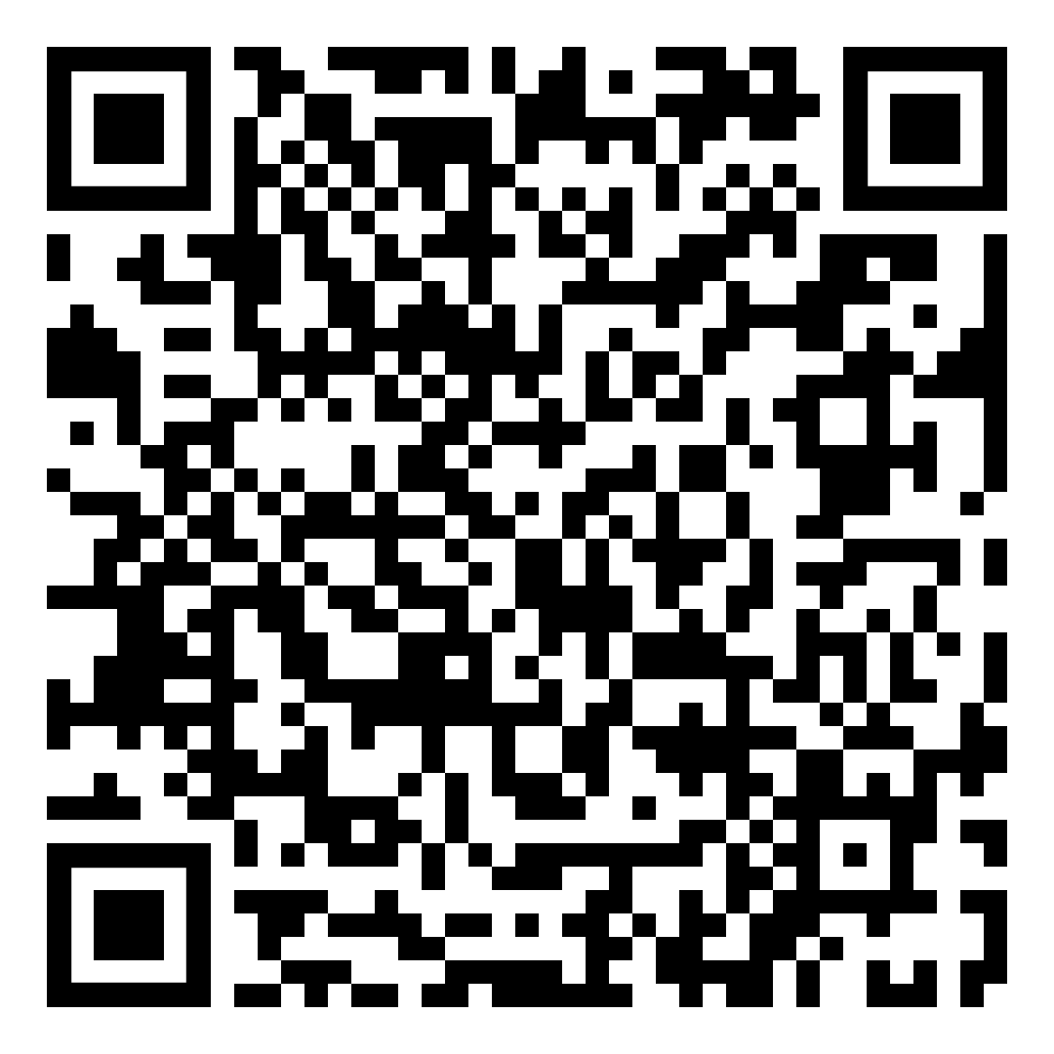


Grade 3 Pollinators
Lesson 2: how to identify a species
QR code: 1

Slide 4
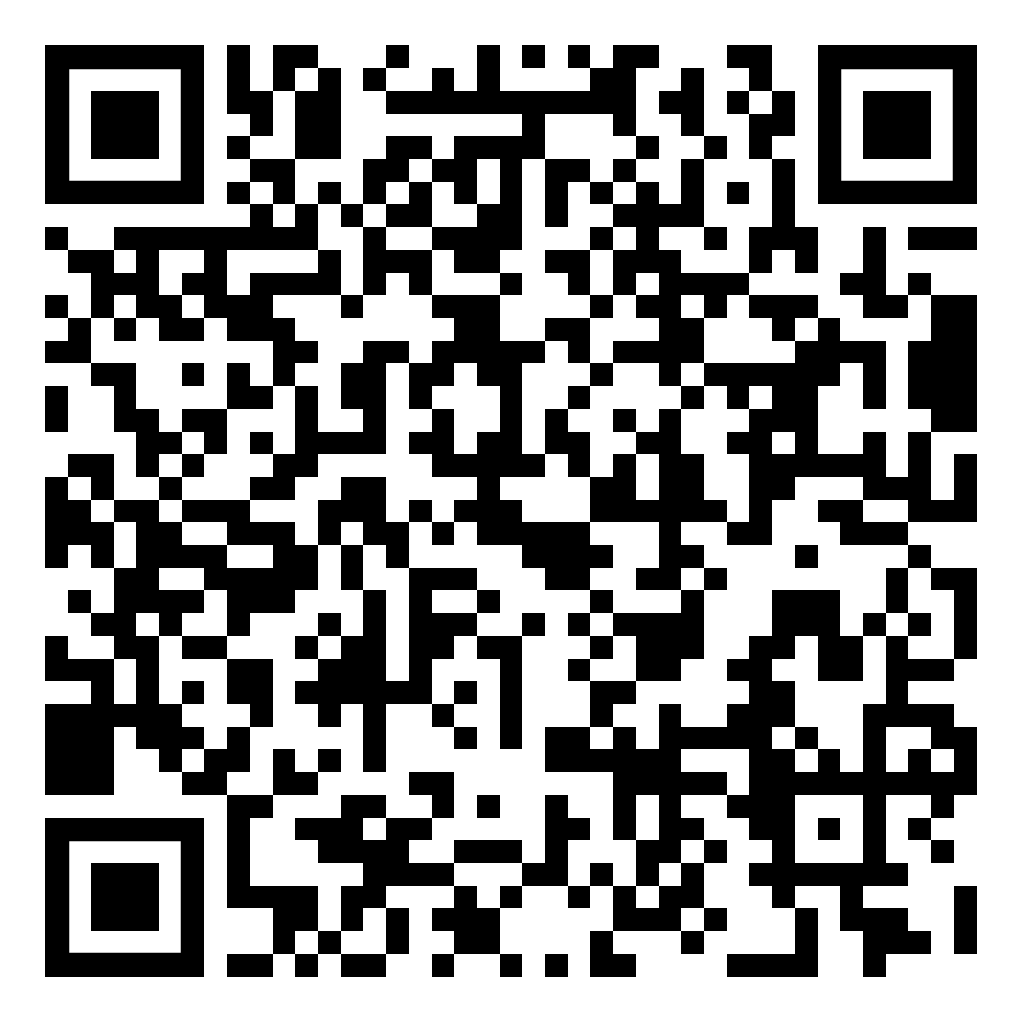
Grade 3 Pollinators
Lesson 2: how to identify a species
QR code: 2

Slide 5
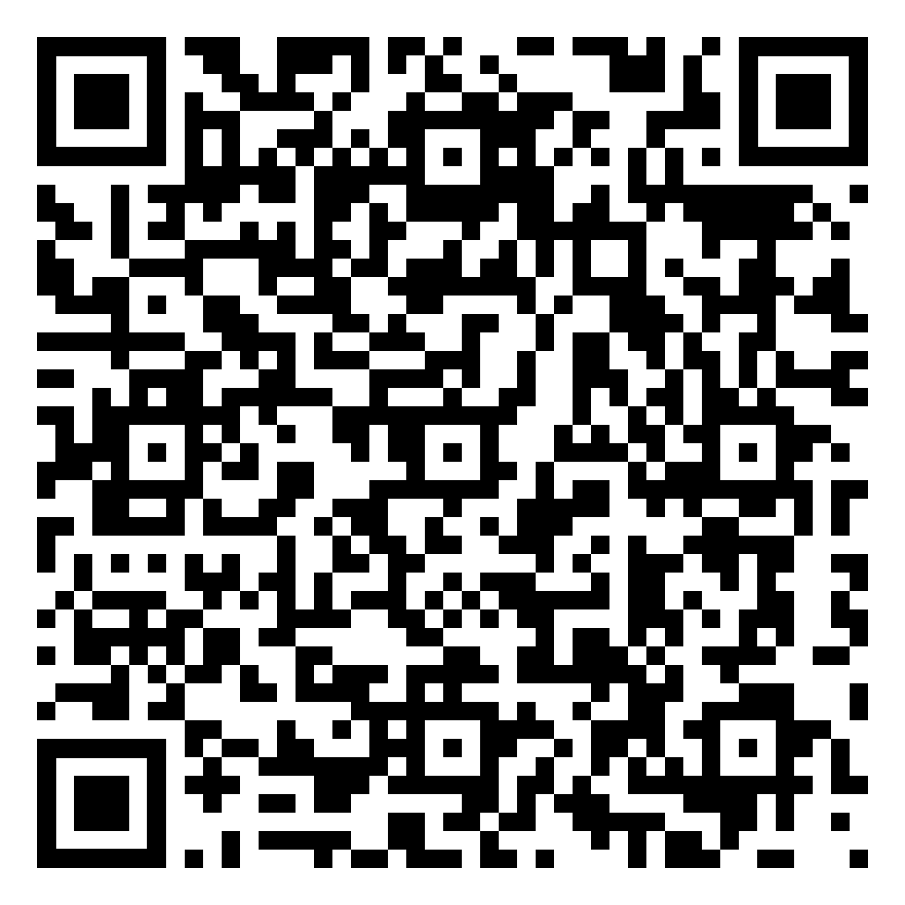
Grade 3 Pollinators
Lesson 2: how to identify a species
QR code: 3

Slide 6
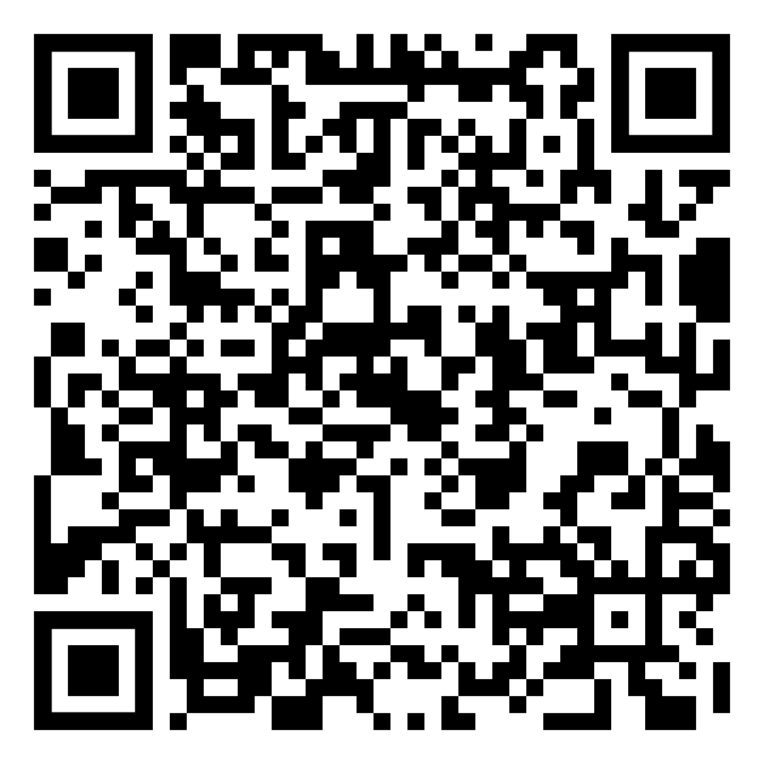
Grade 3 Pollinators
Lesson 2: how to identify a species
QR code: 4

Slide 7
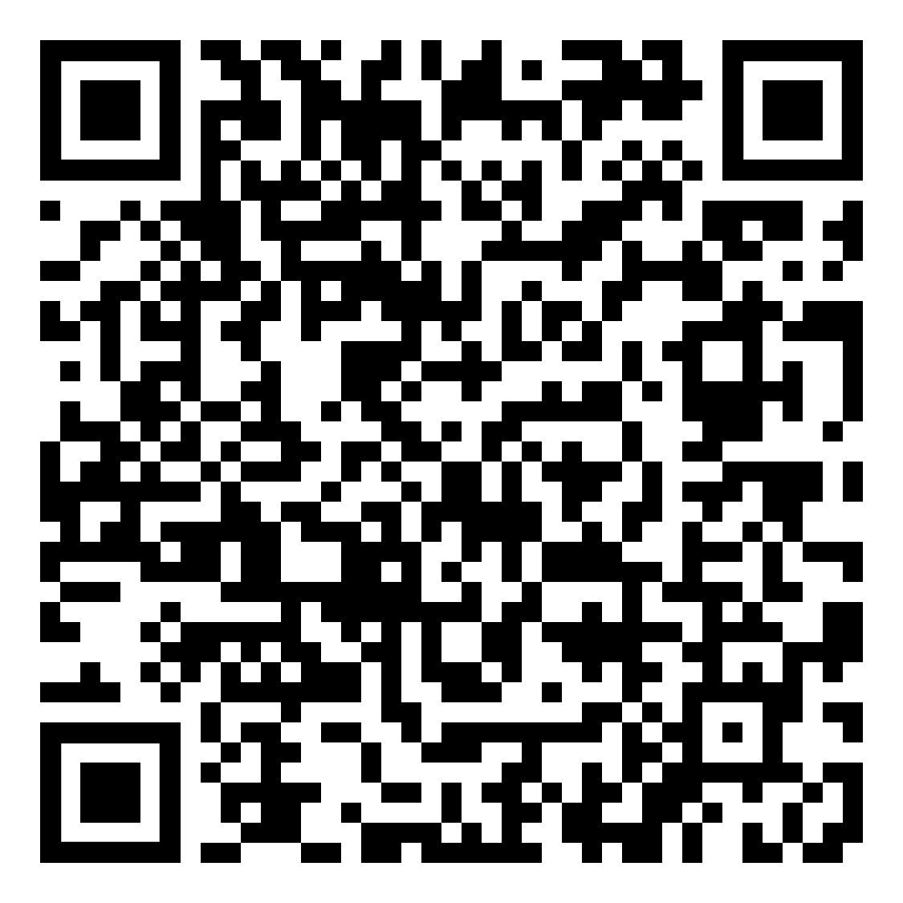
Grade 3 Pollinators
Lesson 2: how to identify a species
QR code: 5

Slide 8
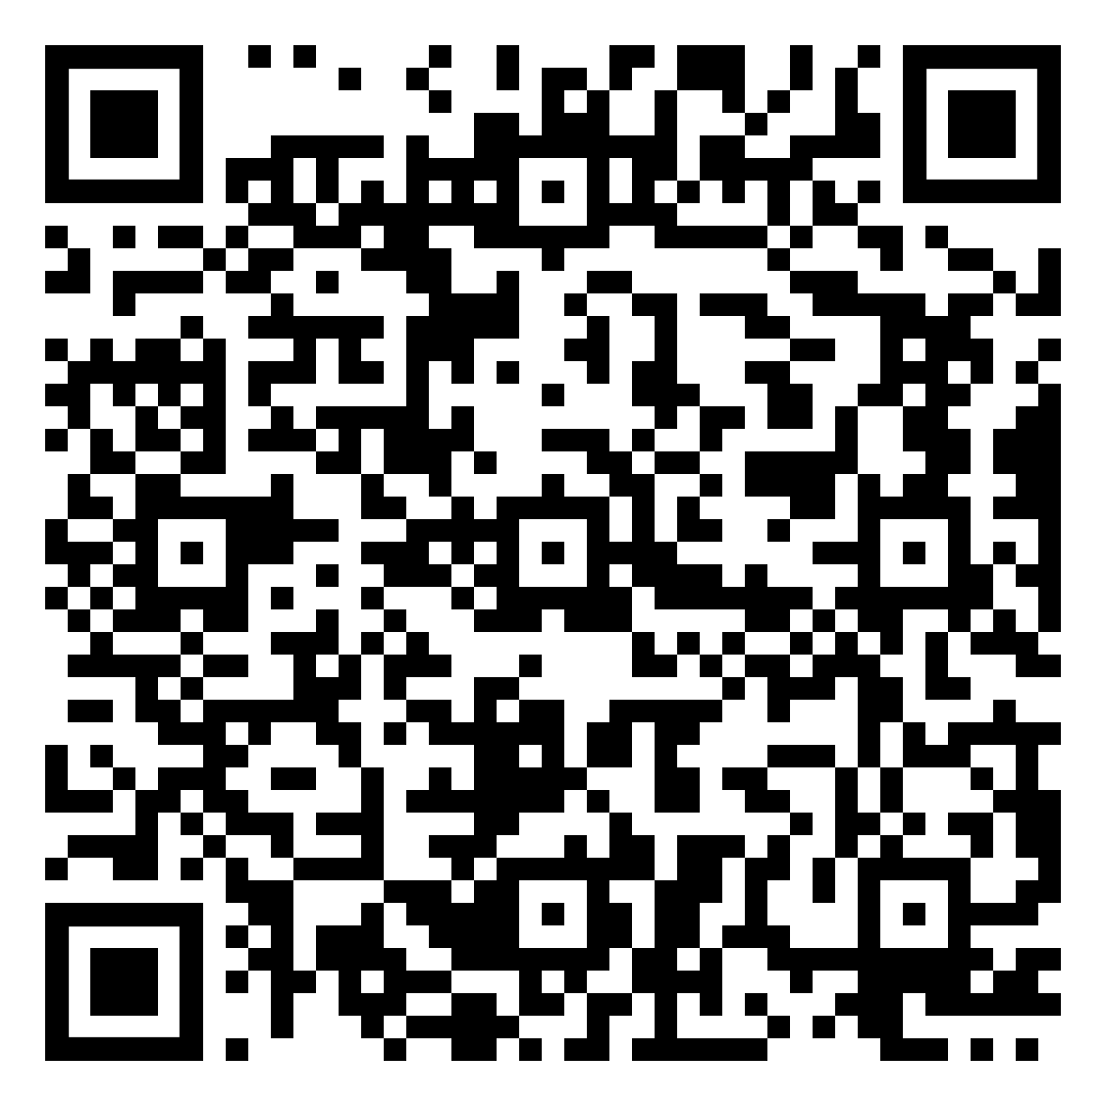
Grade 3 Pollinators
Lesson 2: how to identify a species
QR code: 6

Slide 9
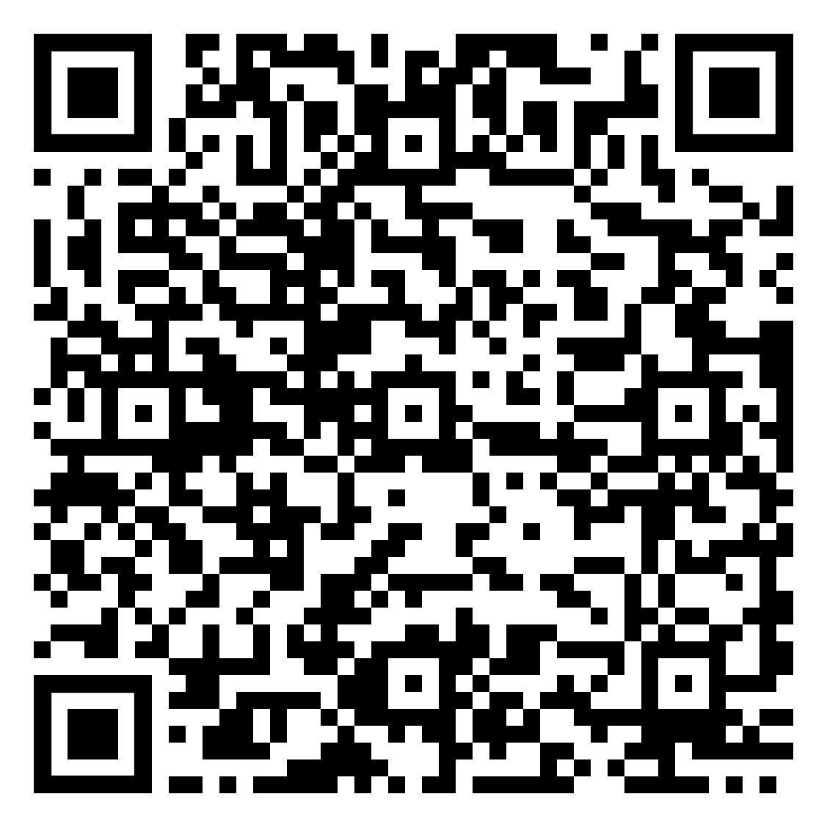
Grade 3 Pollinators
Lesson 2: how to identify a species
QR code: 7

Slide 10
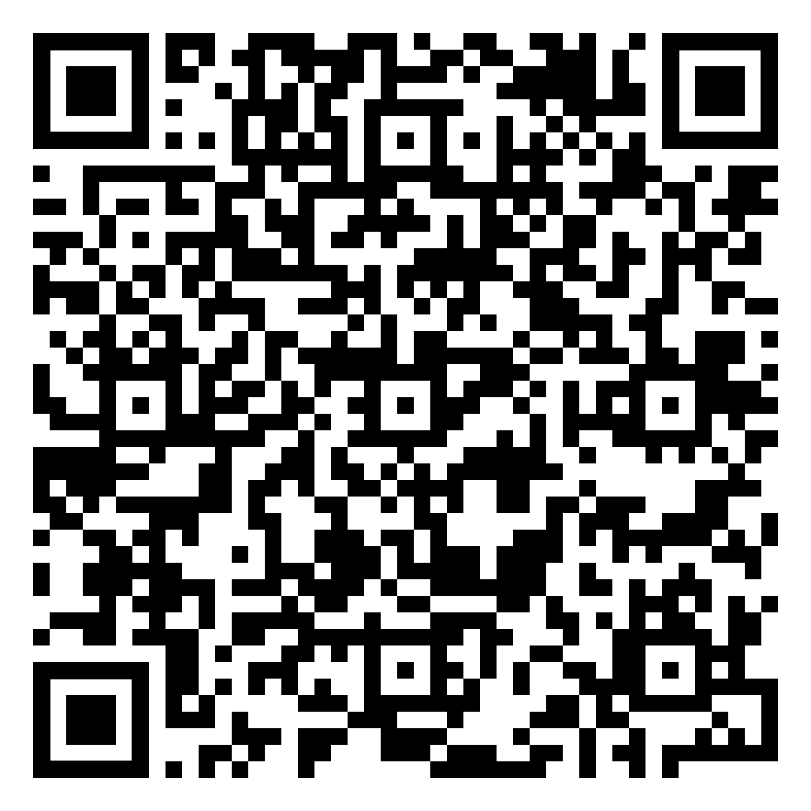
Grade 3 Pollinators
Lesson 2: how to identify a species
QR code: 8

Slide 11
Grade 6 Pollinators
Biofacts and QR codes:
1.Hunts bumblebee
2. Pale yellowtail butterfly
3. Alaska Yellowjacket
4. Horse fly
5. Parasite fly
6. Red-tailed flesh fly
7. American white admiral butterfly
8. Monarch butterfly

Slide 12
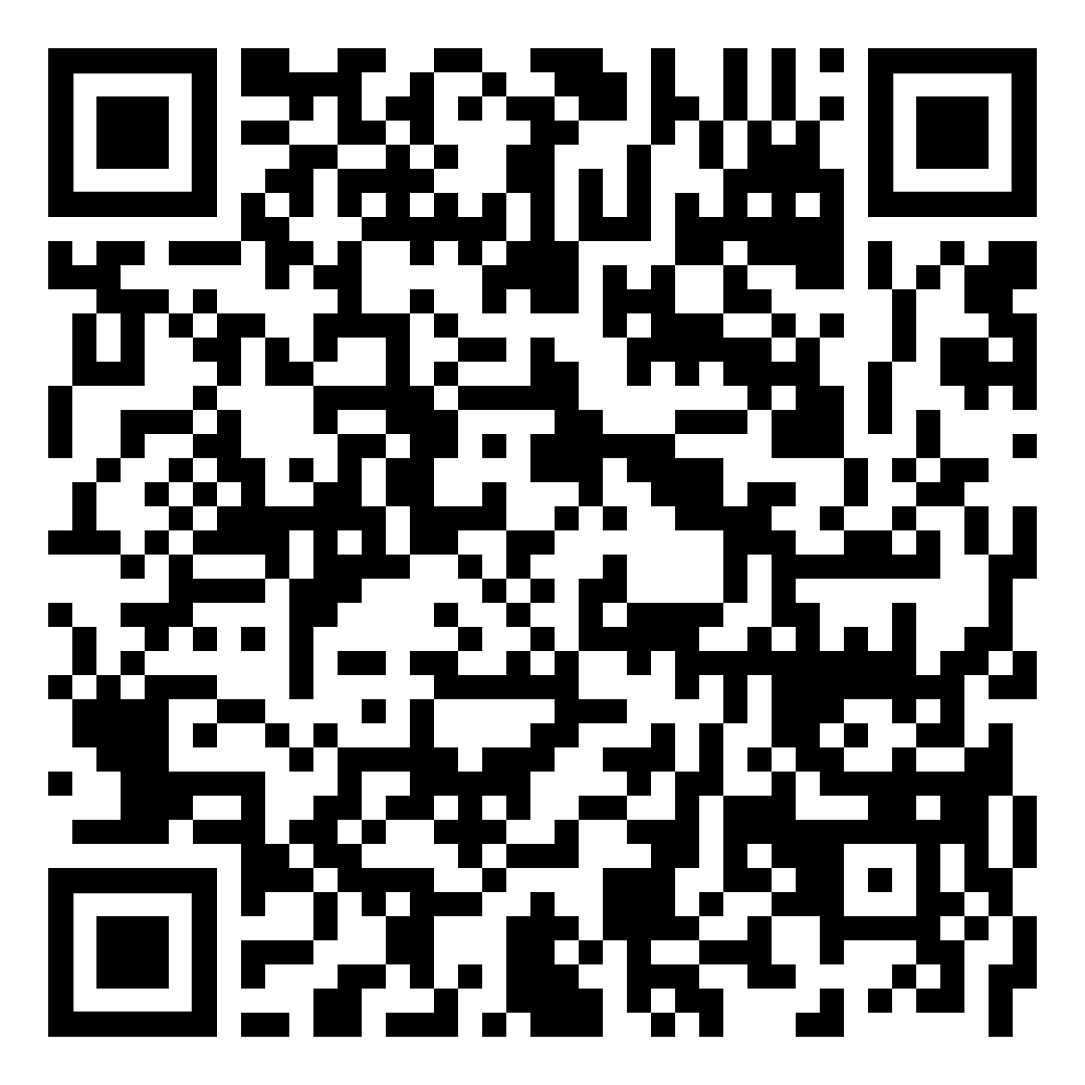
Grade 6 Pollinators
Lesson 2: how to identify a species
QR code: 1

Slide 13
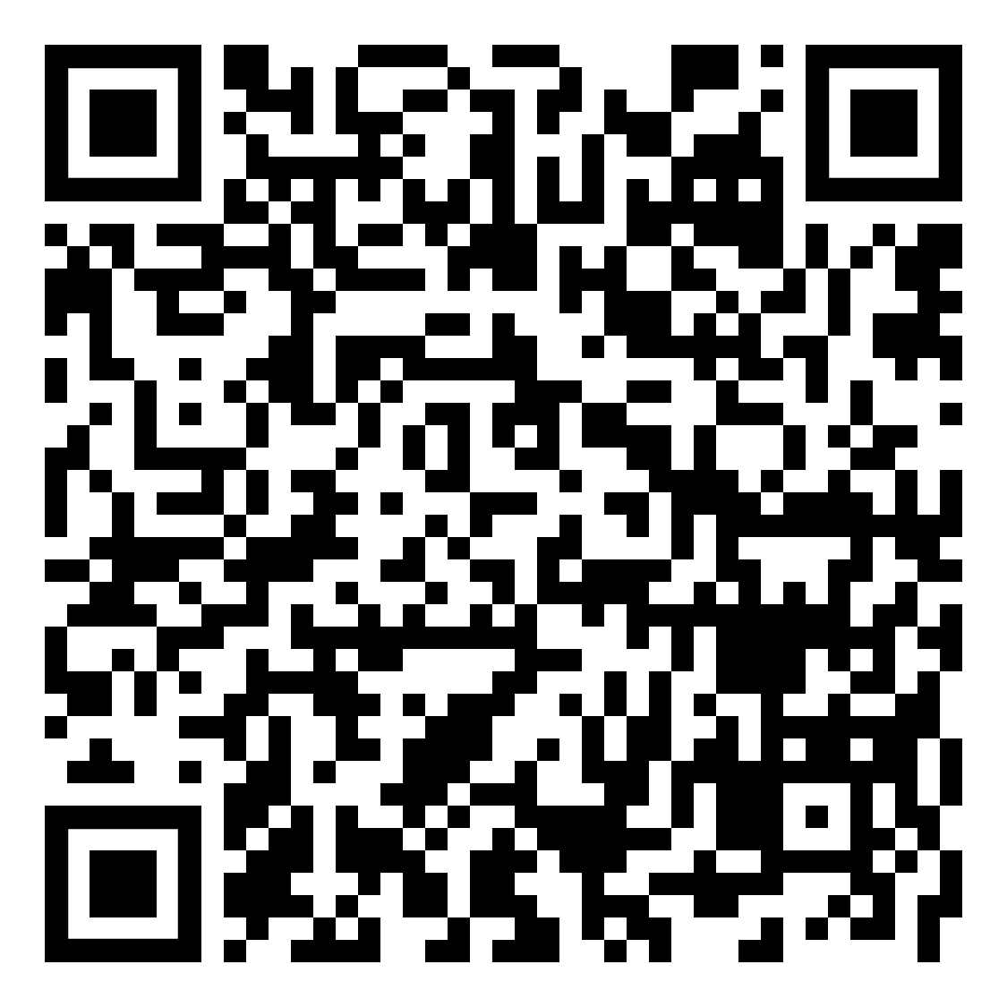
Grade 6 Pollinators
Lesson 2: how to identify a species
QR code: 2

Slide 14
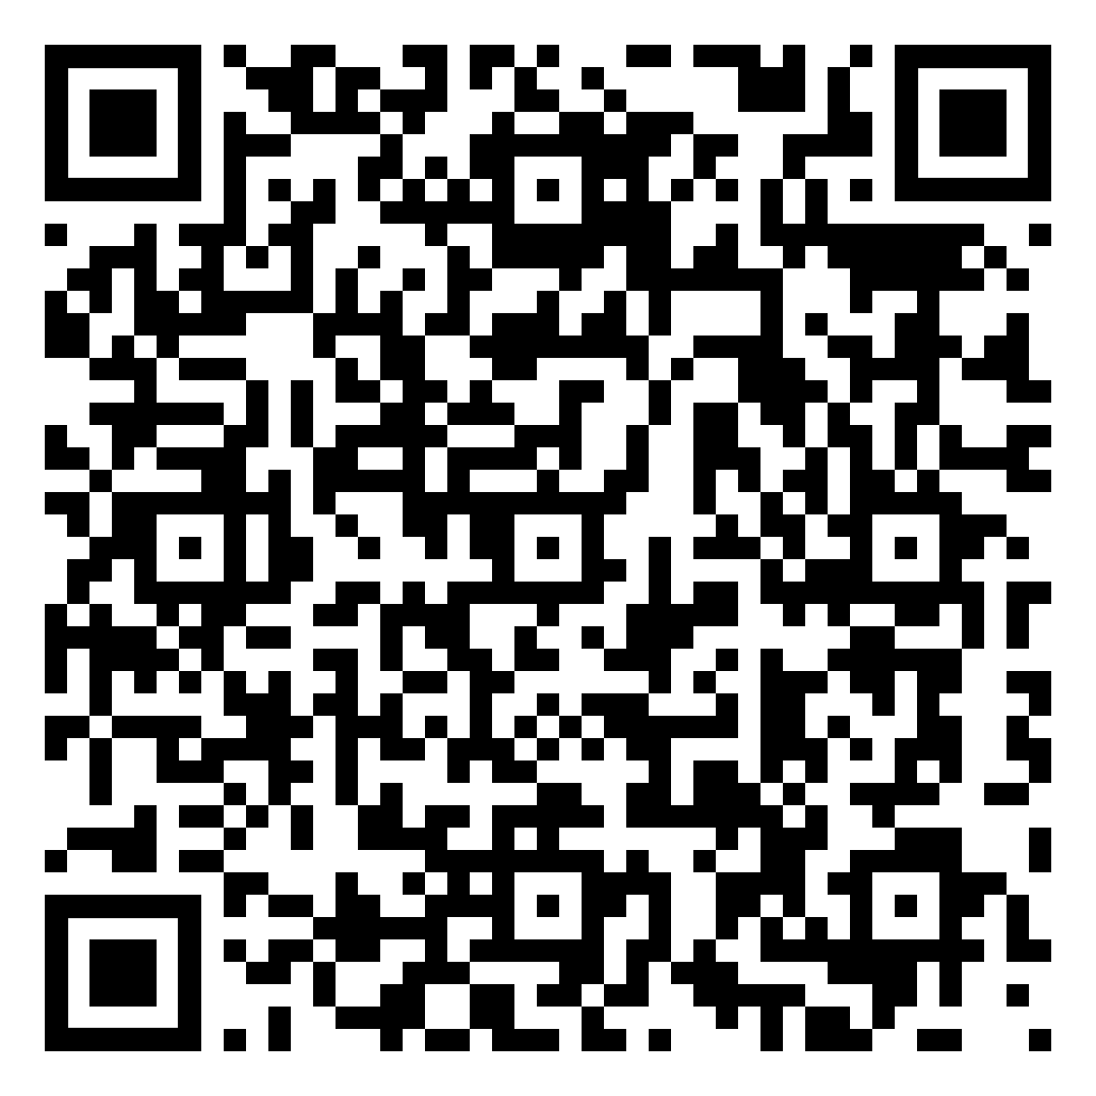
Grade 6 Pollinators
Lesson 2: how to identify a species
QR code: 3

Slide 15
Grade 6 Pollinators
Lesson 2: how to identify a species
QR code: 4

Slide 16
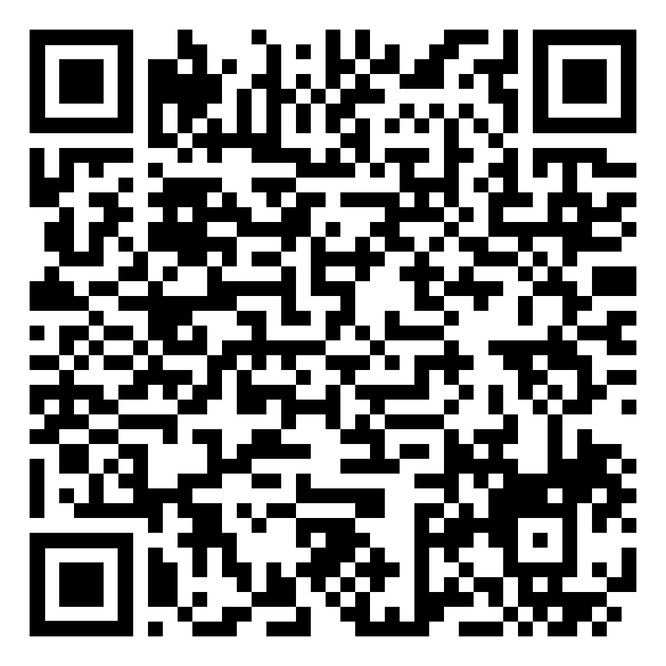
Grade 6 Pollinators
Lesson 2: how to identify a species
QR code: 5

Slide 17
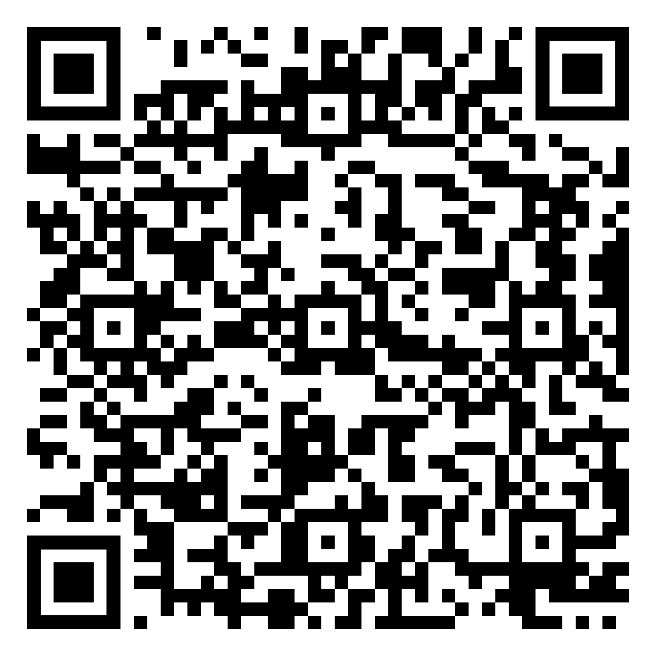
Grade 6 Pollinators
Lesson 2: how to identify a species
QR code: 6

Slide 18
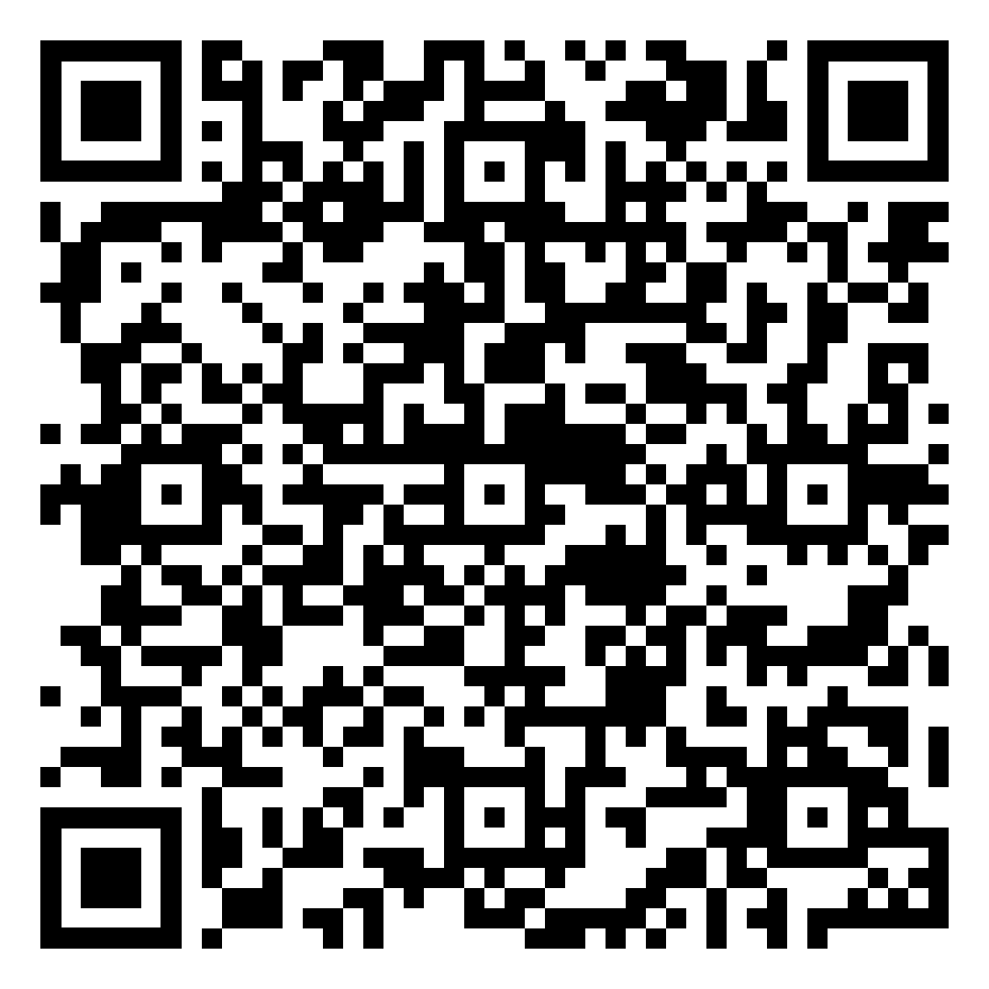
Grade 6 Pollinators
Lesson 2: how to identify a species
QR code: 7

Slide 19
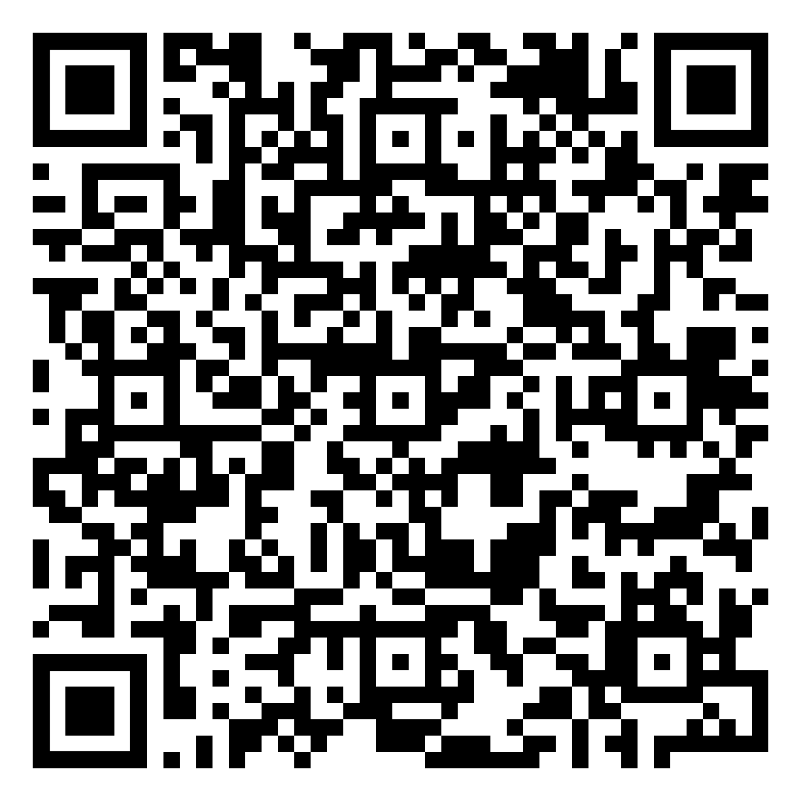
Grade 6 Pollinators
Lesson 2: how to identify a species
QR code: 8

Slide 20
Grade 3
Birds
Biofacts and QR codes:
10. Crow skull replica
11. Northern flicker feather
14. Dried leaves White Ash
15. Great horned owl pellet
16. Goose track mold
17. Red tailed hawk talon (replica)
18. Dried leaves Lombardy Poplar

Slide 21
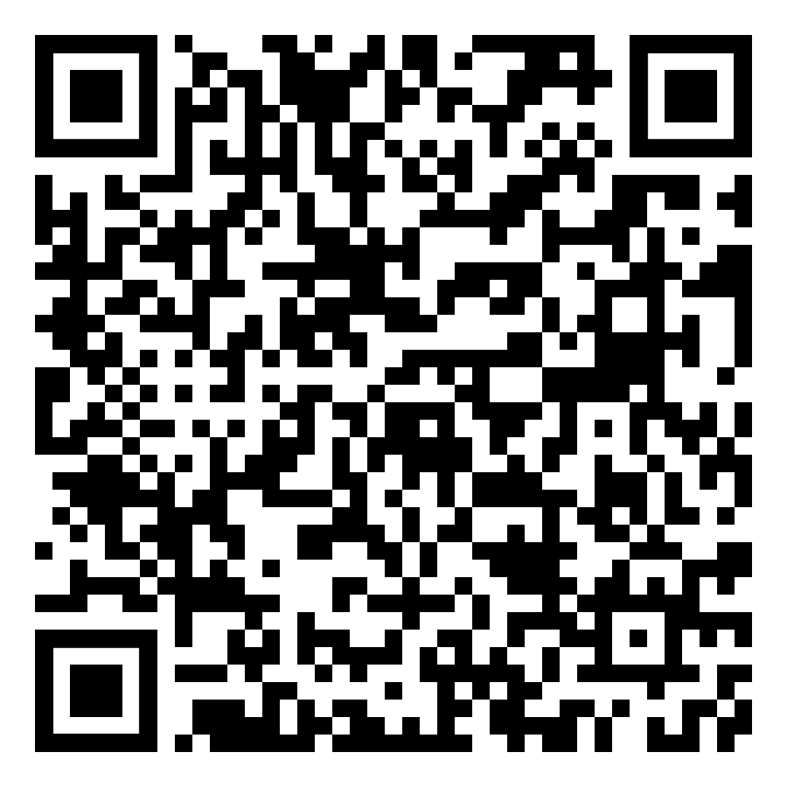
Grade 3 Birds
Lesson 2: how to identify a species
QR code: 10

Slide 22
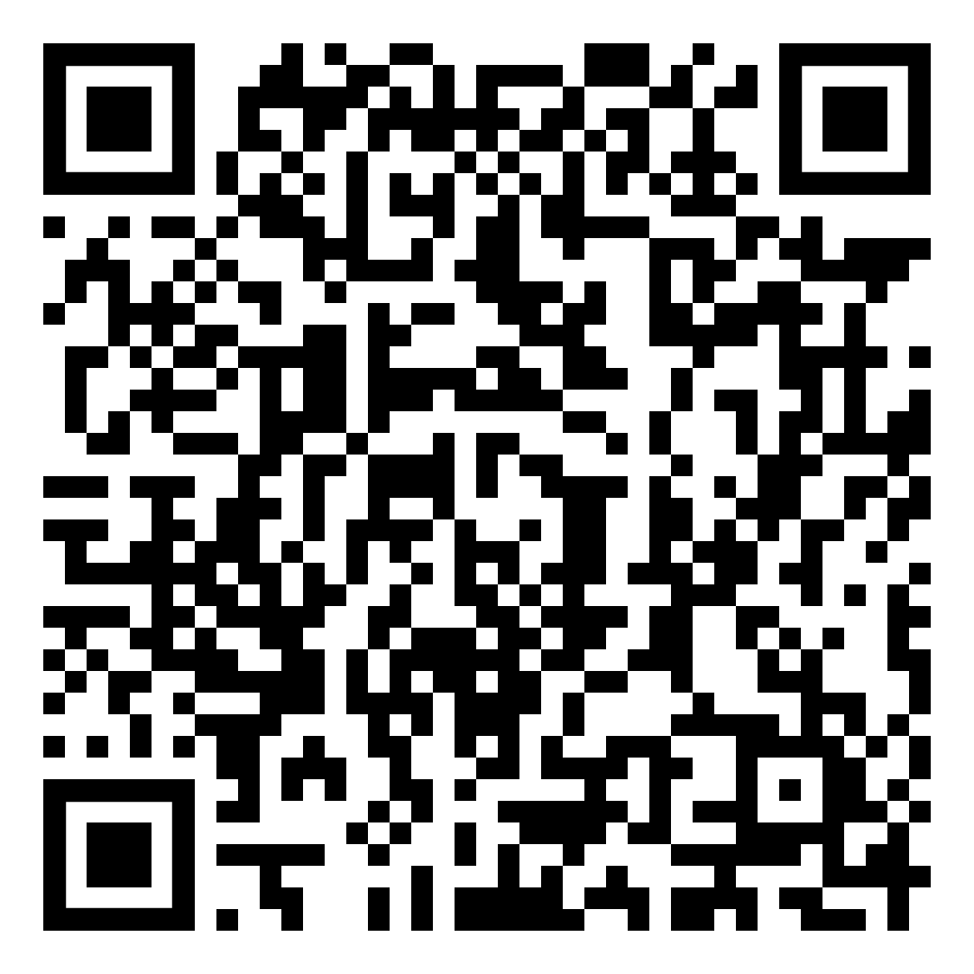
Grade 3 Birds
Lesson 2: how to identify a species
QR code: 11

Slide 23
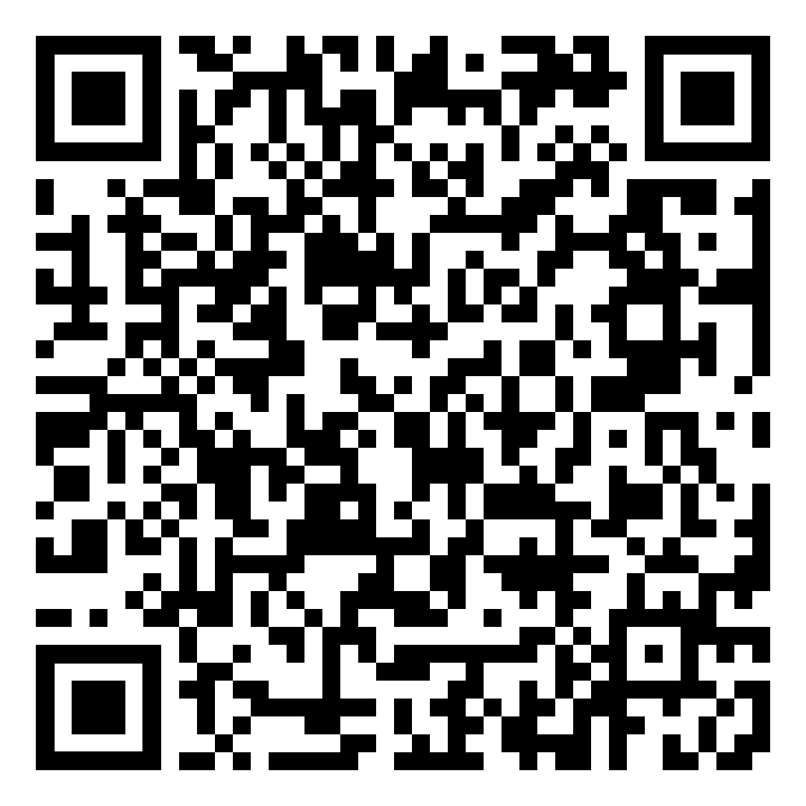
Grade 3 Birds
Lesson 2: how to identify a species
QR code: 14

Slide 24
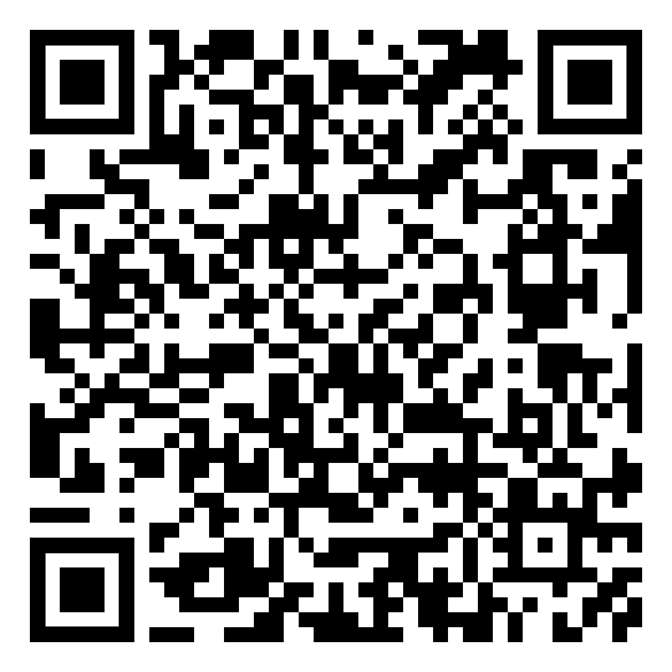
Grade 3 Birds
Lesson 2: how to identify a species
QR code: 15

Slide 25
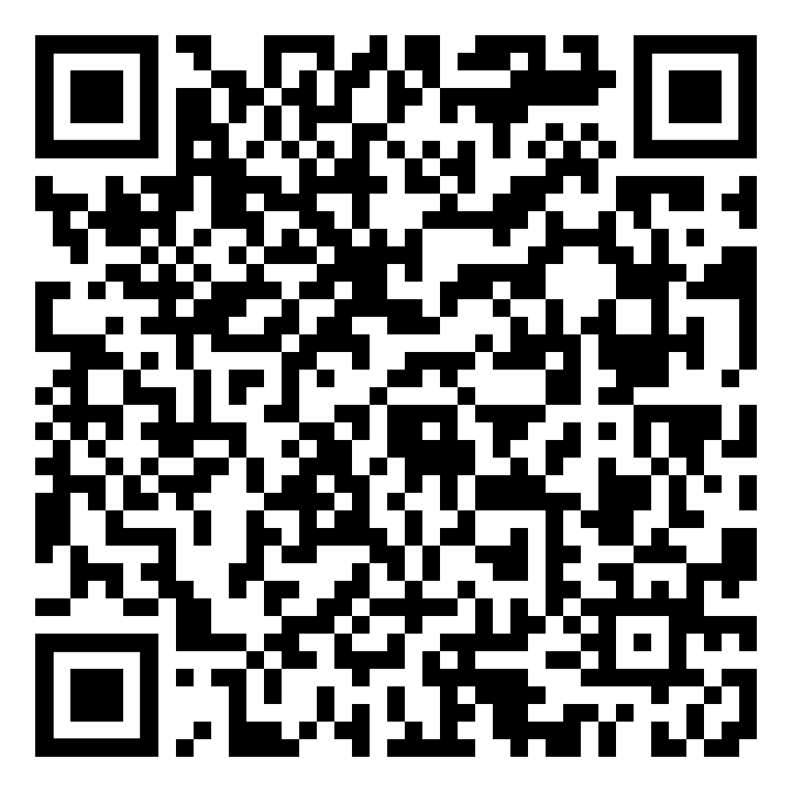
Grade 3 Birds
Lesson 2: how to identify a species
QR code: 16

Slide 26
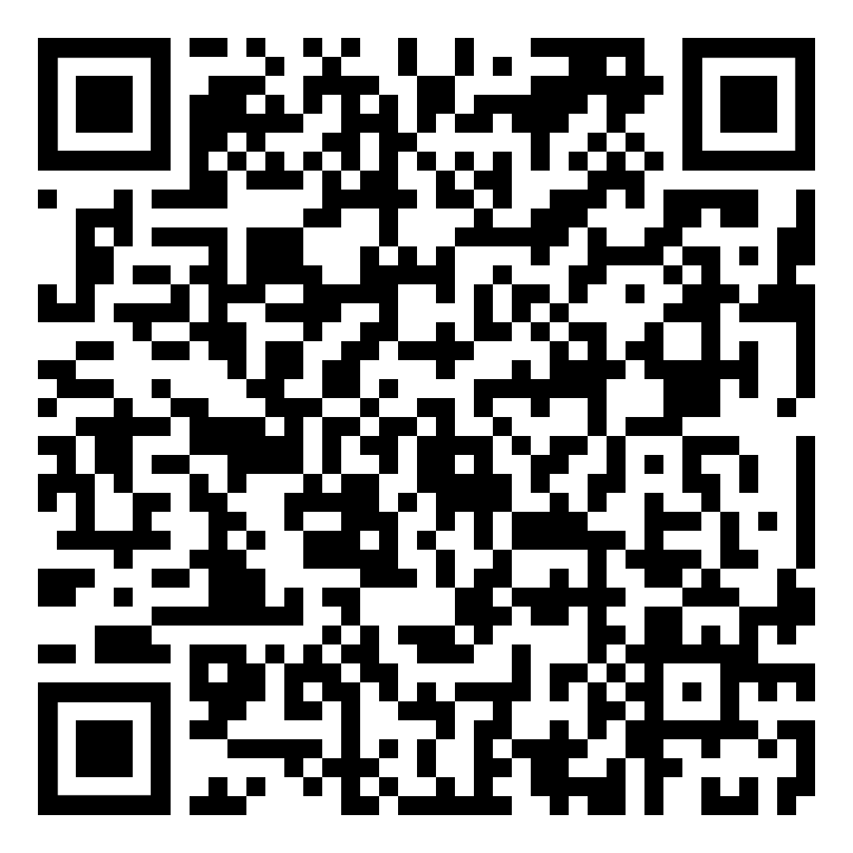
Grade 3 Birds
Lesson 2: how to identify a species
QR code: 17

Slide 27
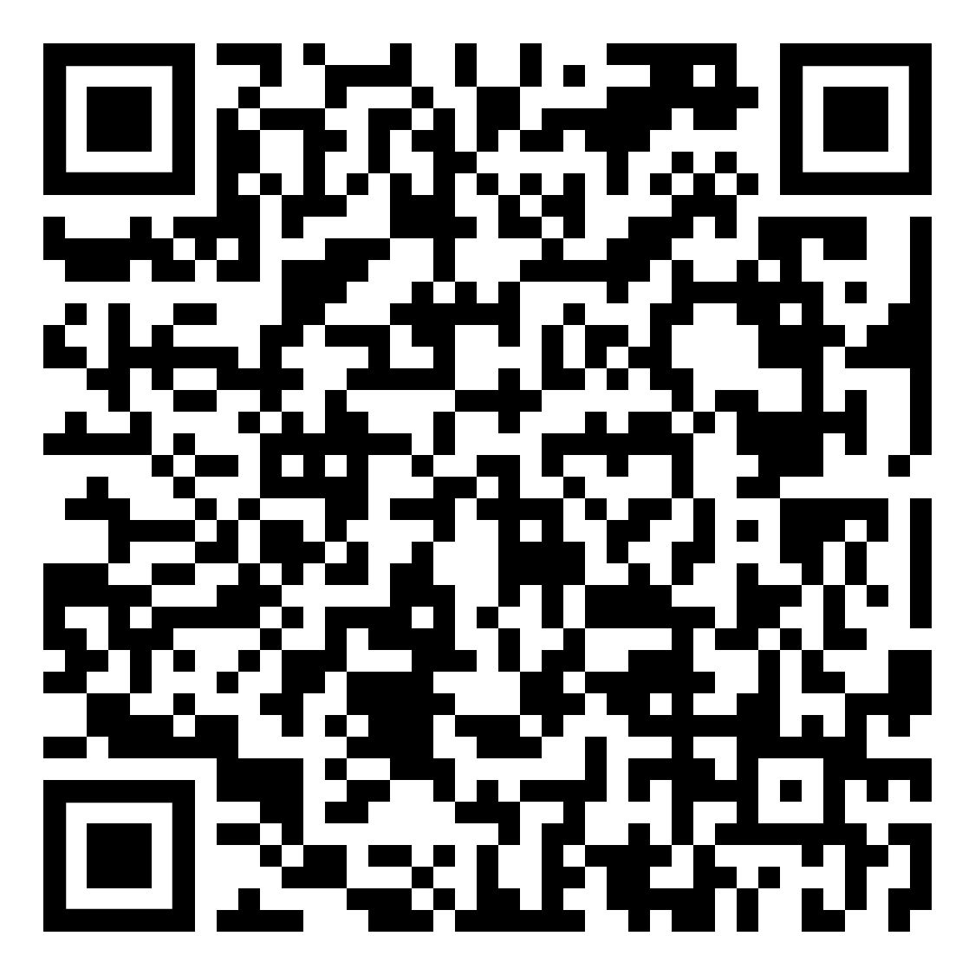
Grade 3 Birds
Lesson 2: how to identify a species
QR code: 18

Slide 28
Grade 6
Birds
Biofacts and QR codes:
10. Crow skull replica
11. Northern flicker feather
14. Dried leaves White Ash
15. Great horned owl pellet
16. Goose track mold
17. Red tailed hawk talon (replica)
18. Dried leaves Lombardy Poplar

Slide 29
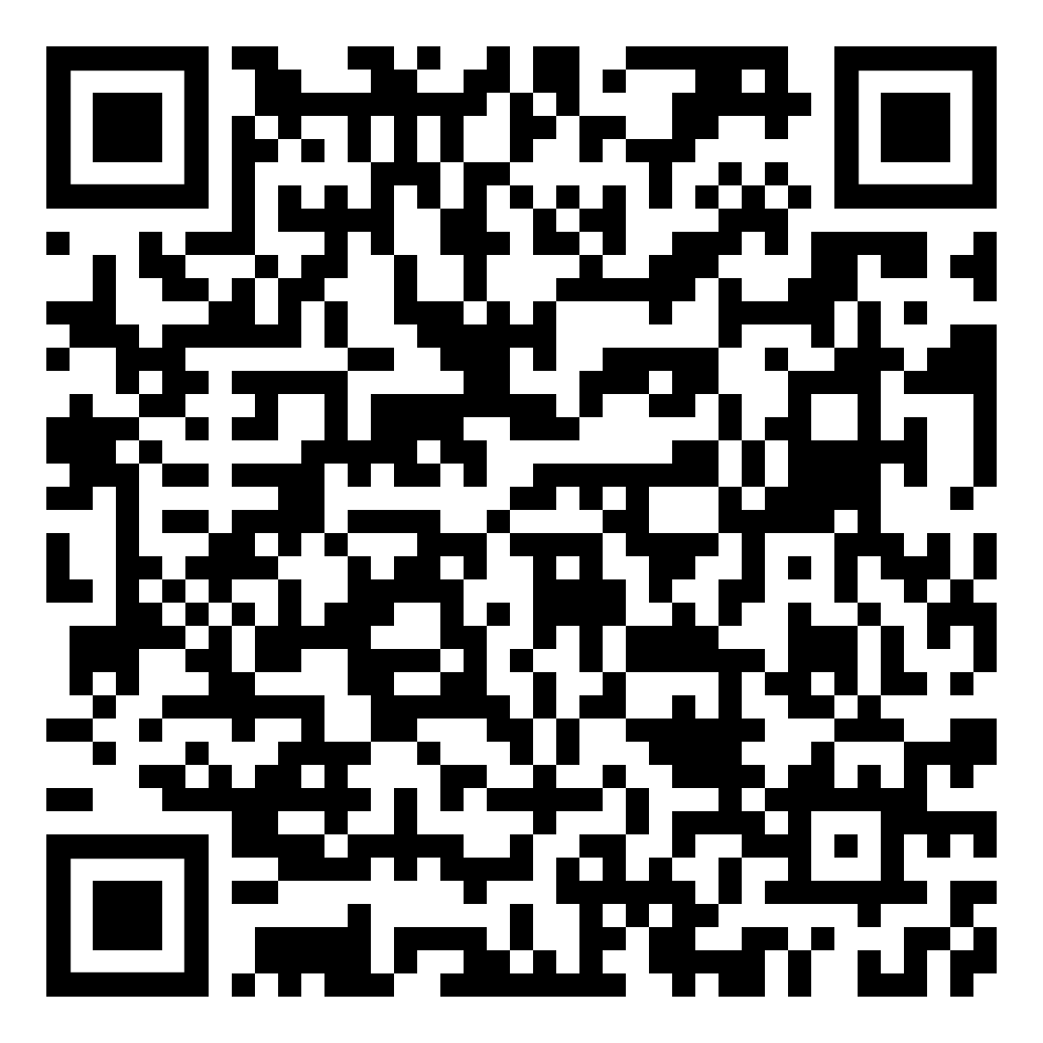
Grade 6 Birds
Lesson 2: how to identify a species
QR code: 10

Slide 30
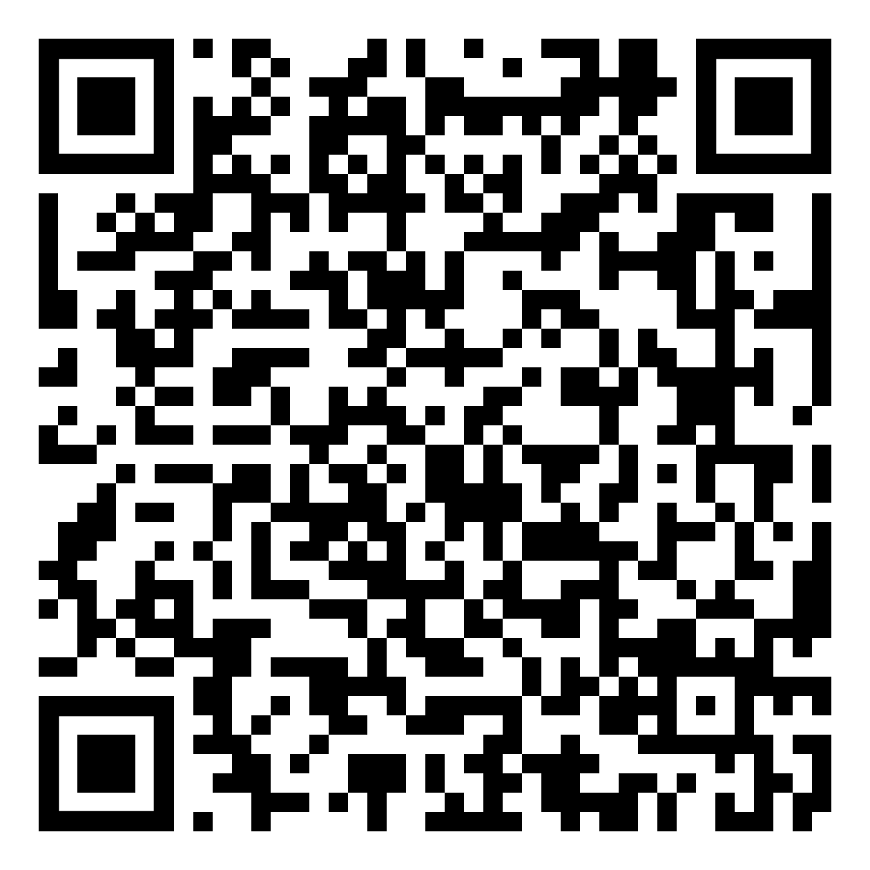
Grade 6 Birds
Lesson 2: how to identify a species
QR code: 11

Slide 31
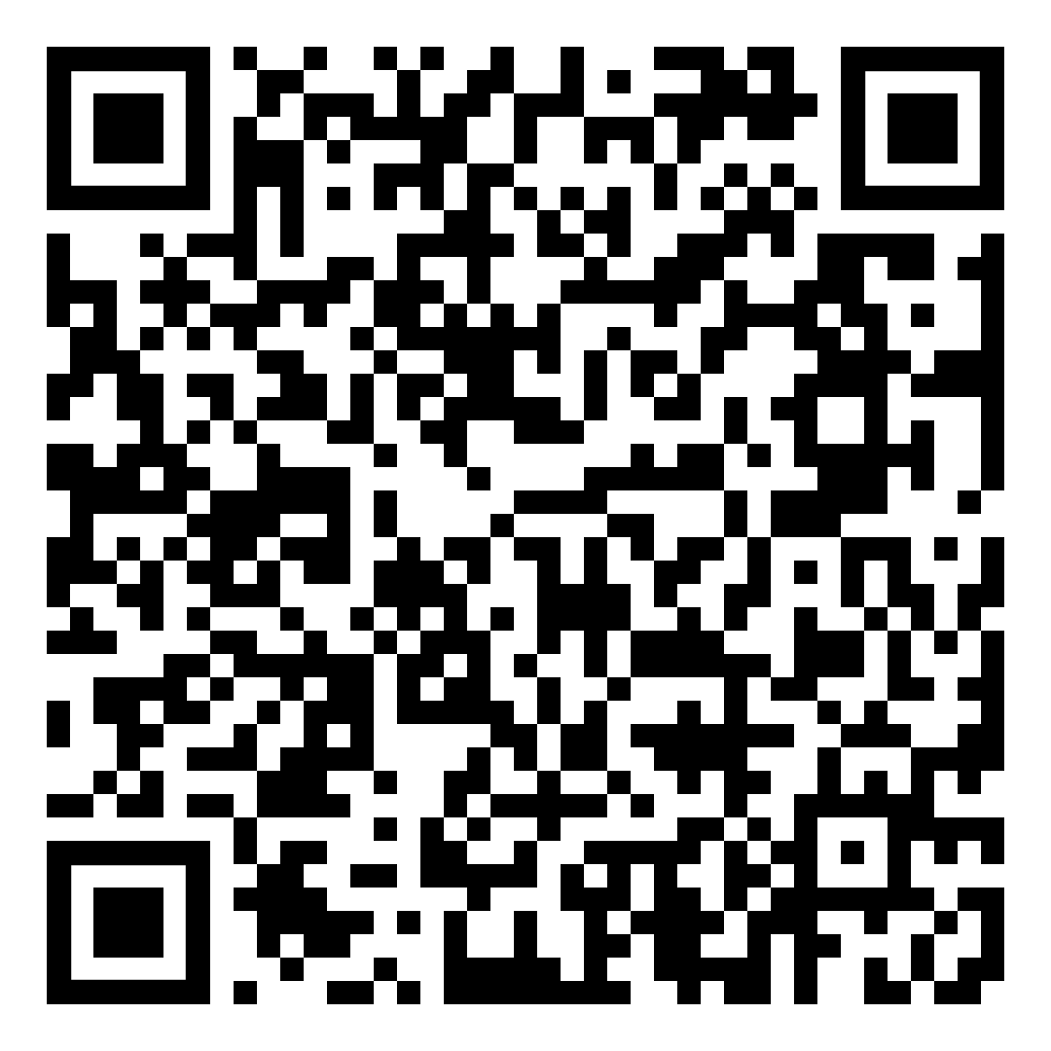
Grade 6 Birds
Lesson 2: how to identify a species
QR code: 14

Slide 32
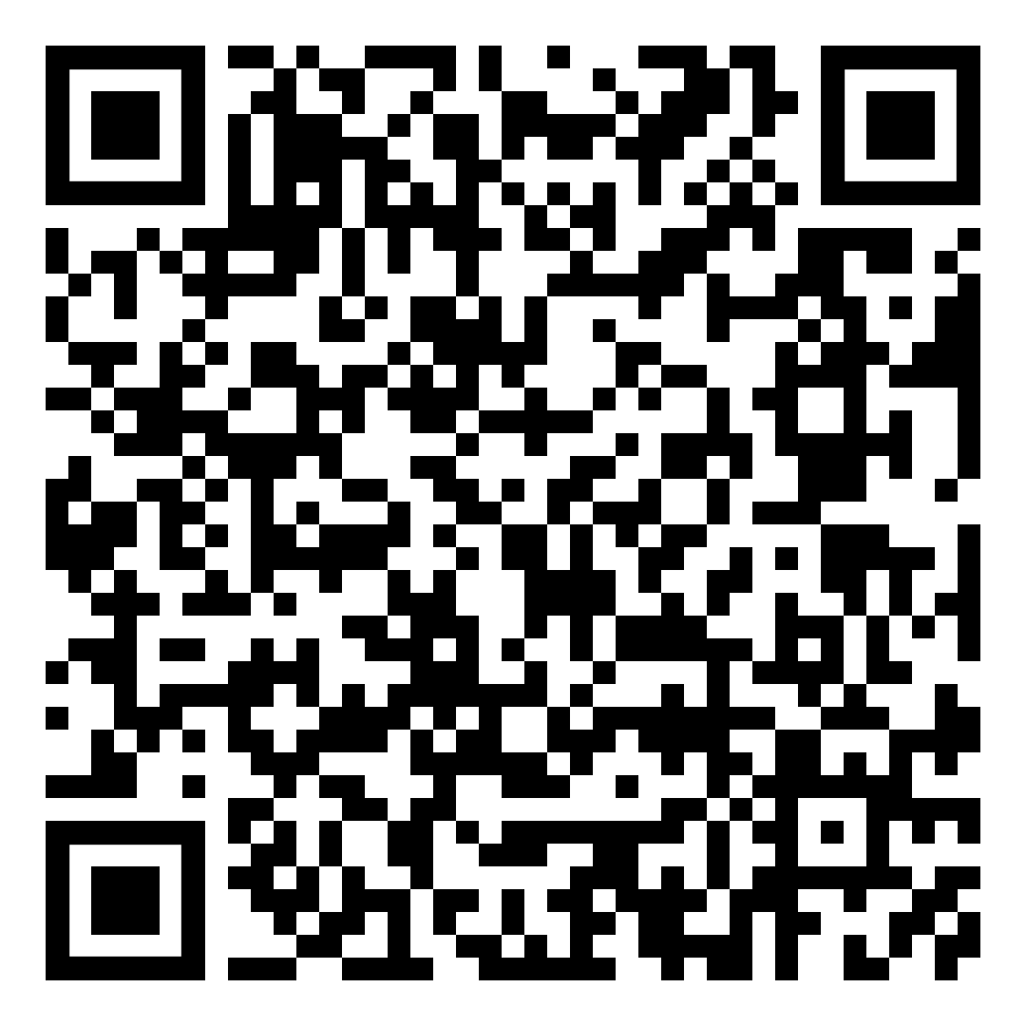
Grade 6 Birds
Lesson 2: how to identify a species
QR code: 15

Slide 33
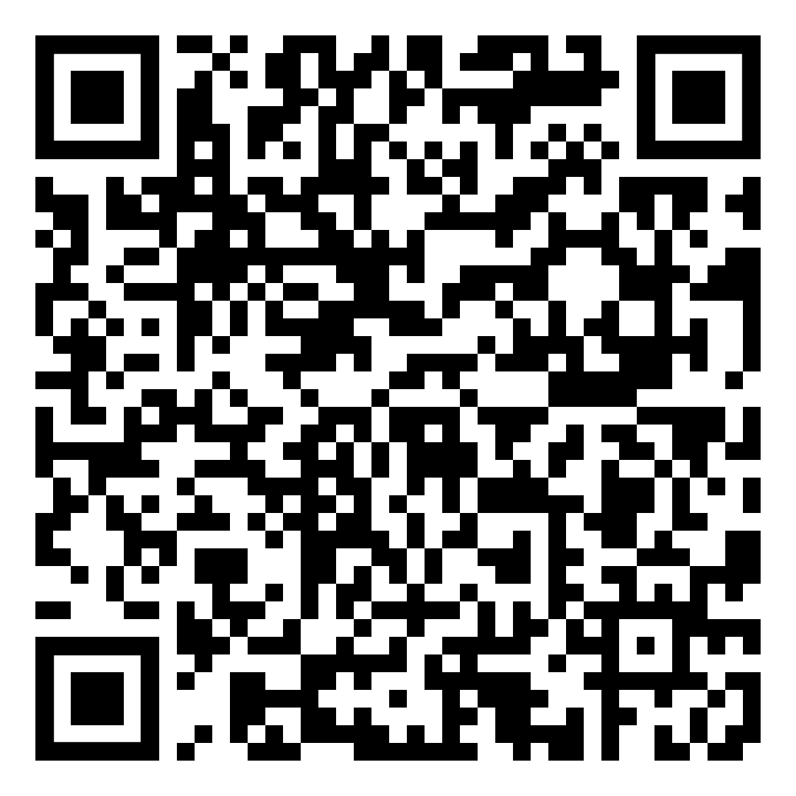
Grade 6 Birds
Lesson 2: how to identify a species
QR code: 16

Slide 34
Grade 6 Birds
Lesson 2: how to identify a species
QR code: 17

Slide 35
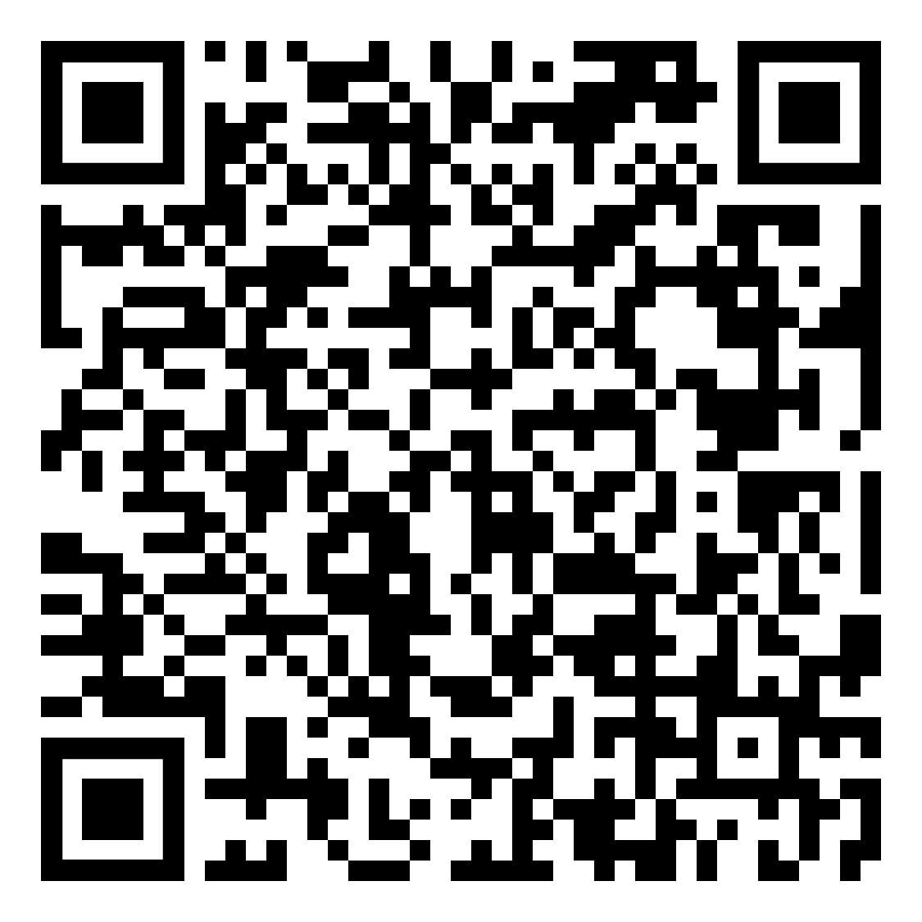
Grade 6 Birds
Lesson 2: how to identify a species
QR code: 18

Slide 36
Grade 7&9
Urban Wildlife
Biofacts and QR codes:
1.Hunts bumblebee
2. Pale yellowtail butterfly
9. American red squirrel skull (replica)
10. American crow skull (replica)
11. Northern flicker feather
12. Mountain cottontail rabbit fur
13. White tailed deer antler

Slide 37
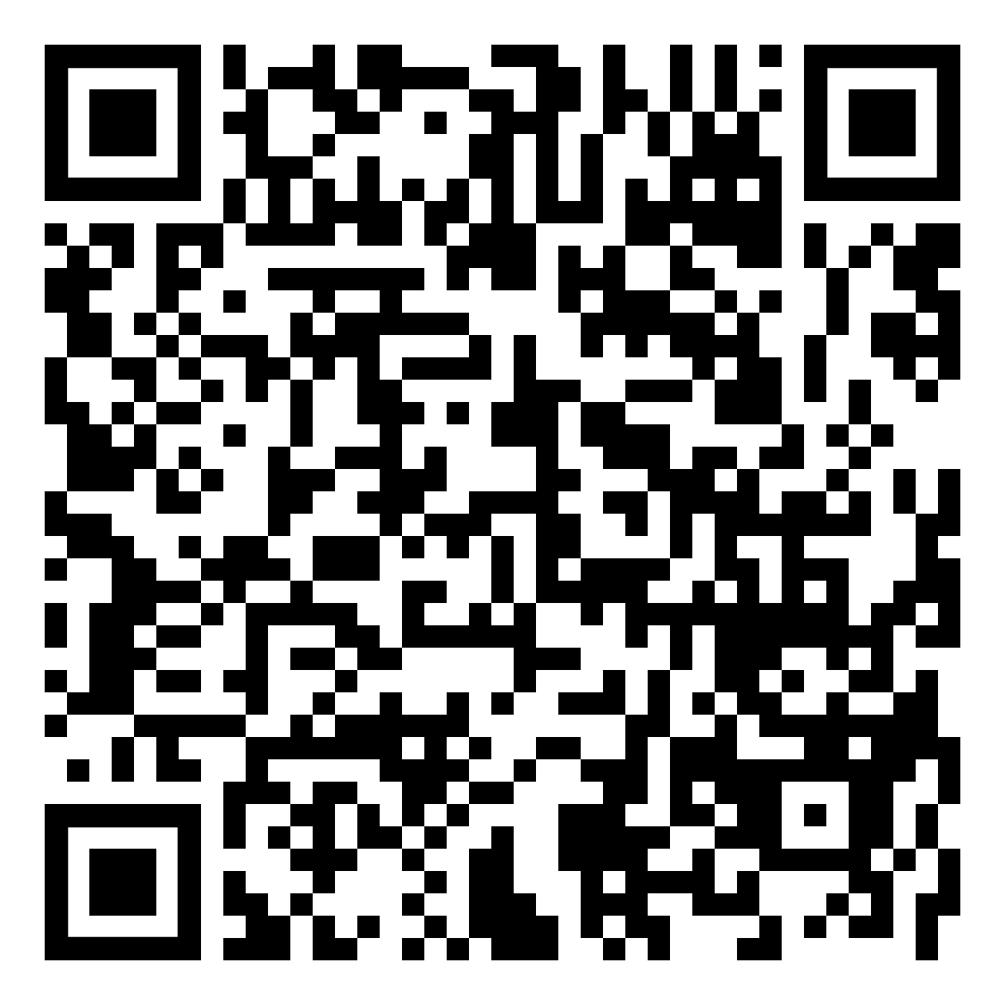
Urban Wildlife
Lesson 2: how to identify a species
QR code: 1

Slide 38
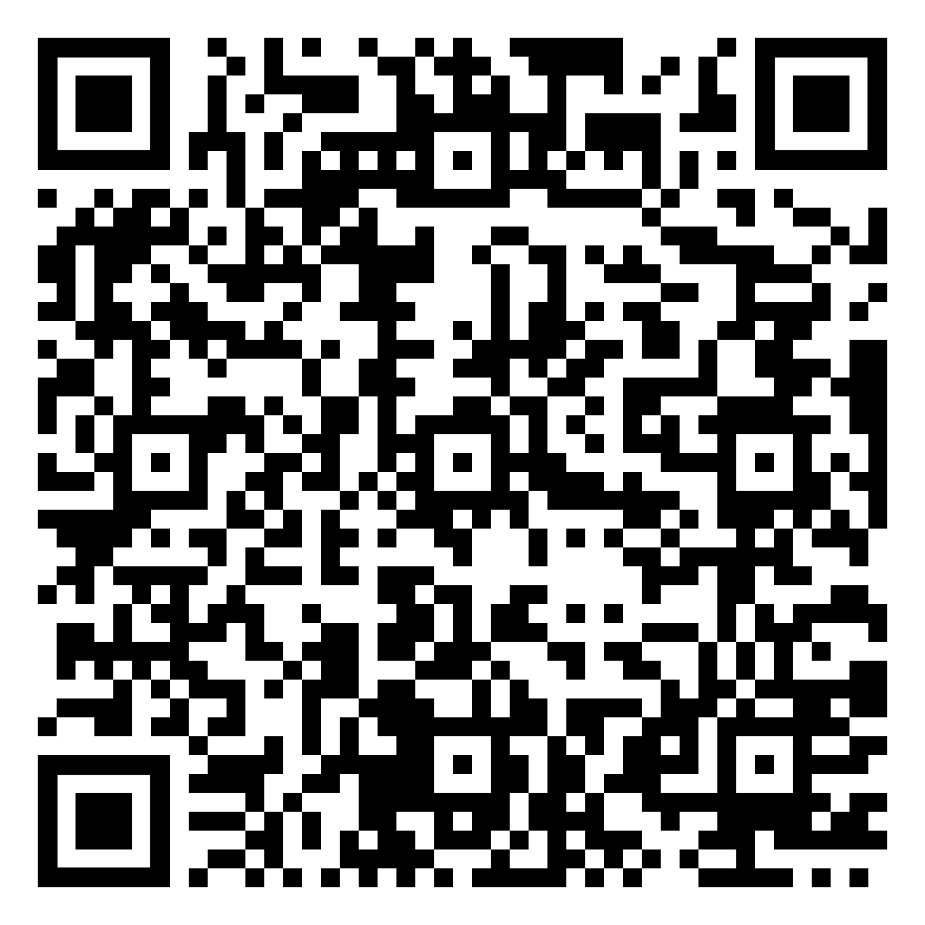
Urban Wildlife
Lesson 2: how to identify a species
QR code: 2

Slide 39
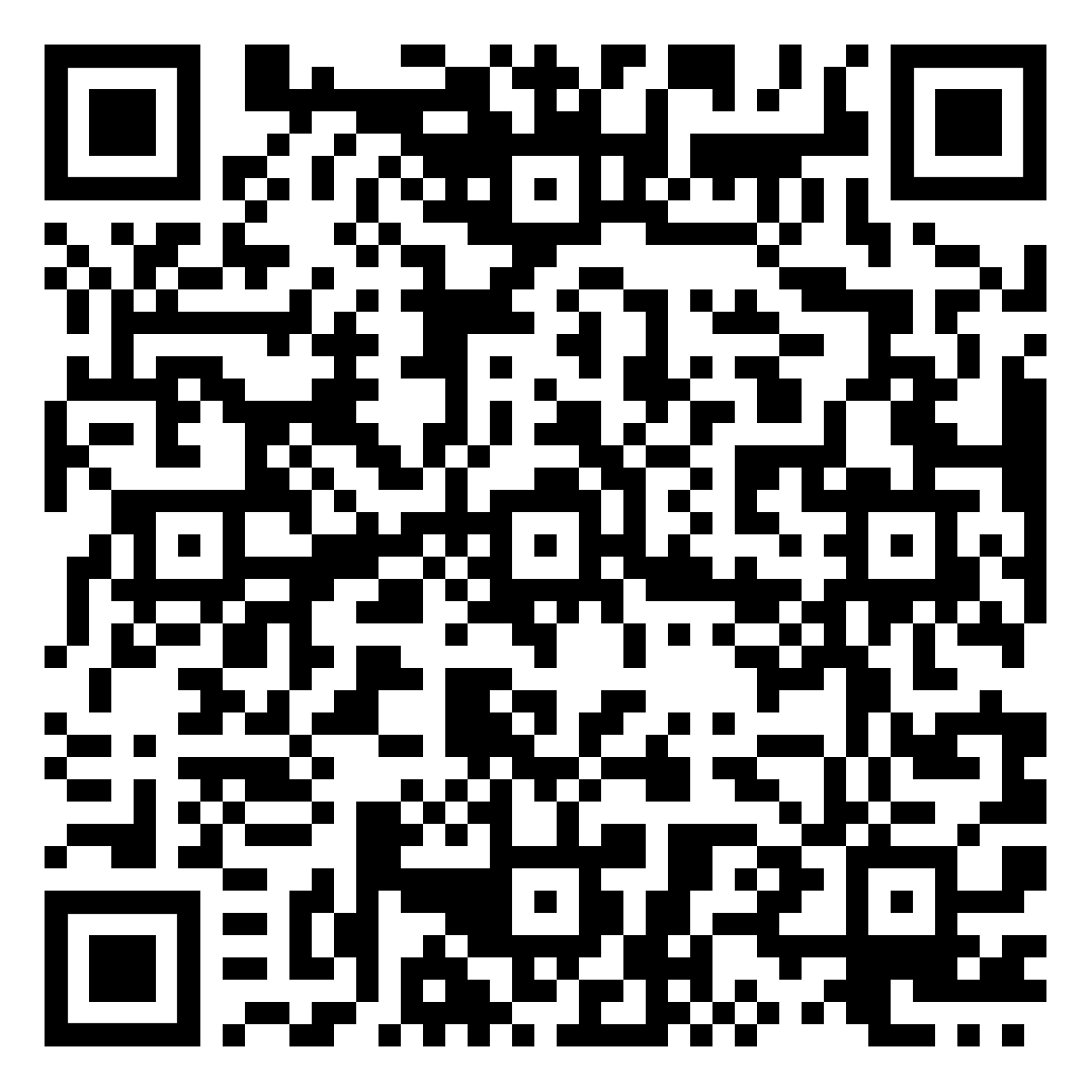
Urban Wildlife
Lesson 2: how to identify a species
QR code: 9

Slide 40
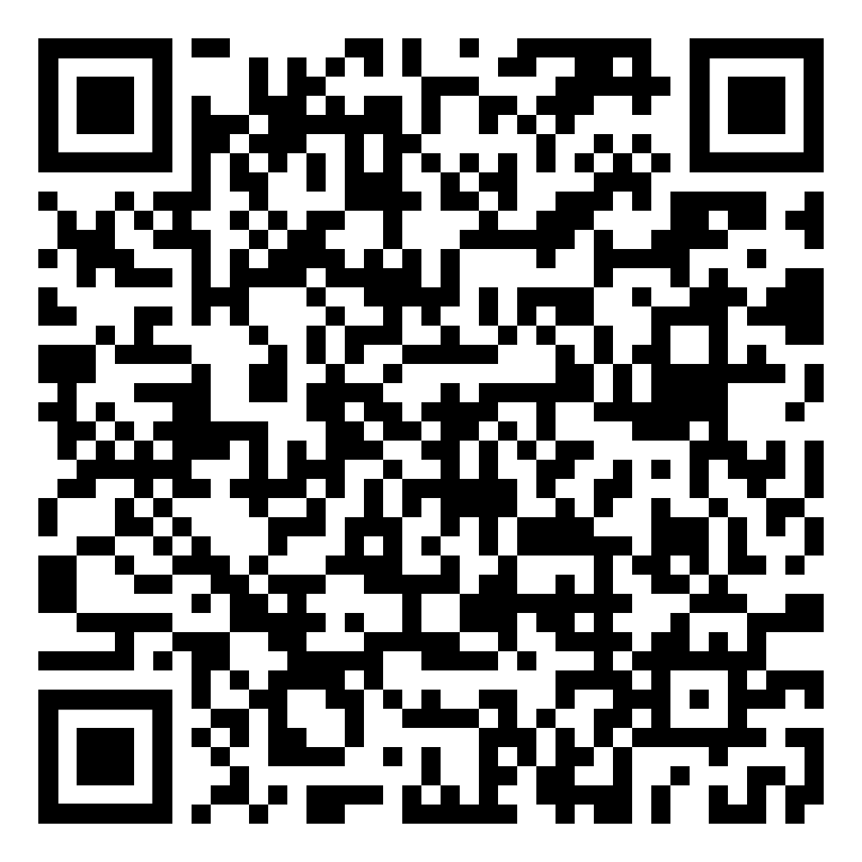
Urban Wildlife
Lesson 2: how to identify a species
QR code: 10

Slide 41
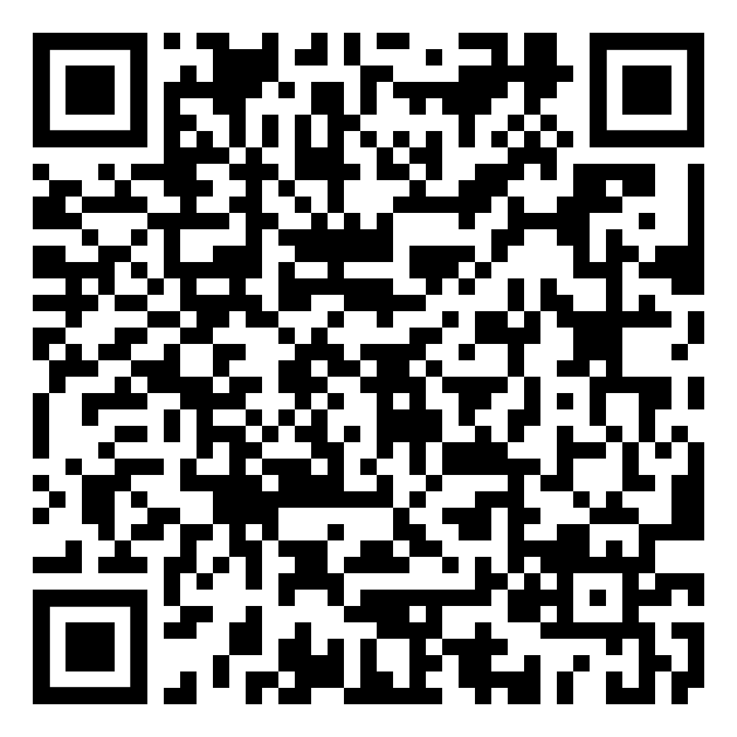
Urban Wildlife
Lesson 2: how to identify a species
QR code: 11

Slide 42
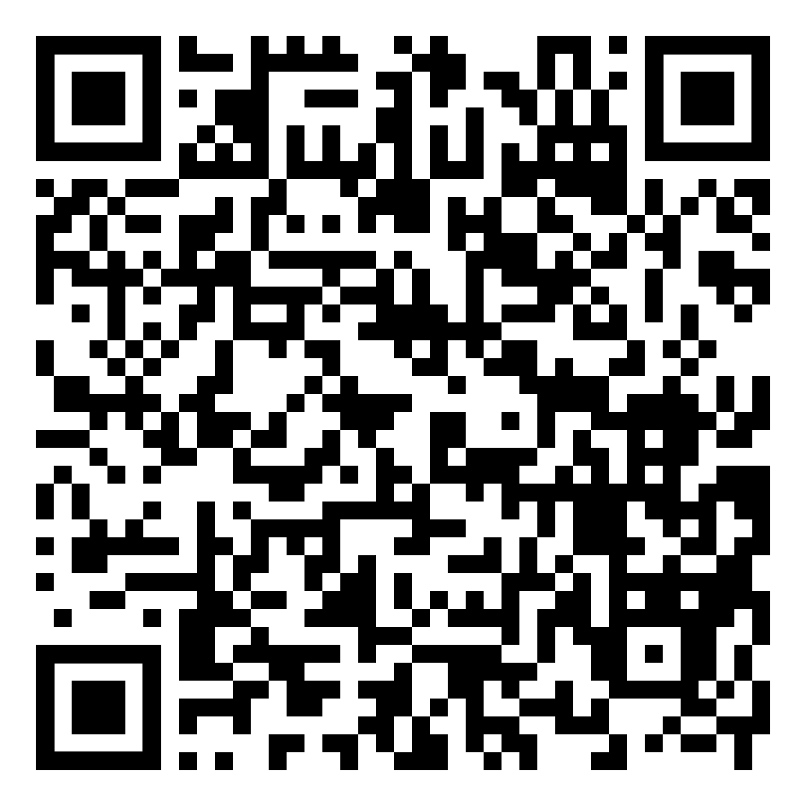
Urban Wildlife
Lesson 2: how to identify a species
QR code: 12

Slide 43
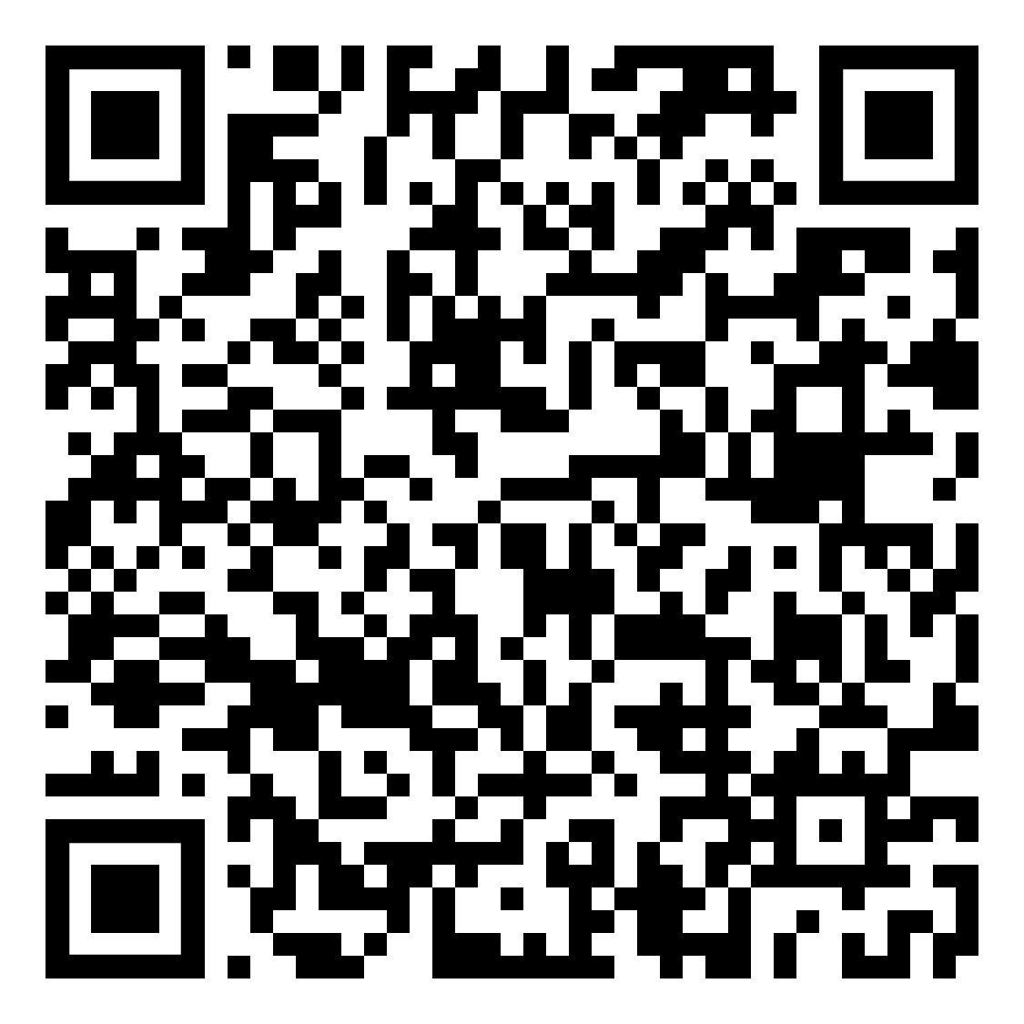
Urban Wildlife
Lesson 2: how to identify a species
QR code: 13

