Slide 1

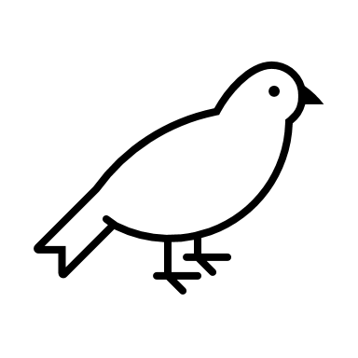





YYC Young
Citizen Scientists:
Birds
Bird Nests

Slide 2

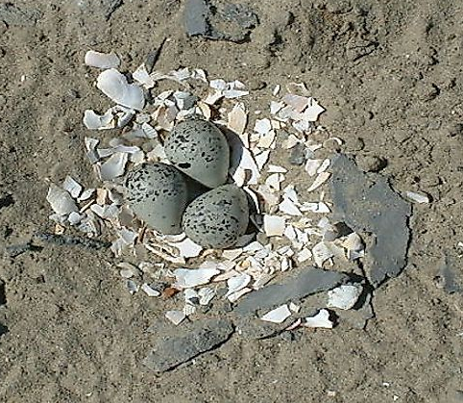
Scrape
Scrape Nests
Scrape nests are:
Shallow depression in the ground
Very simple to build
Eggs are usually camouflaged
Nestlings leave the nest soon after birth

Slide 3
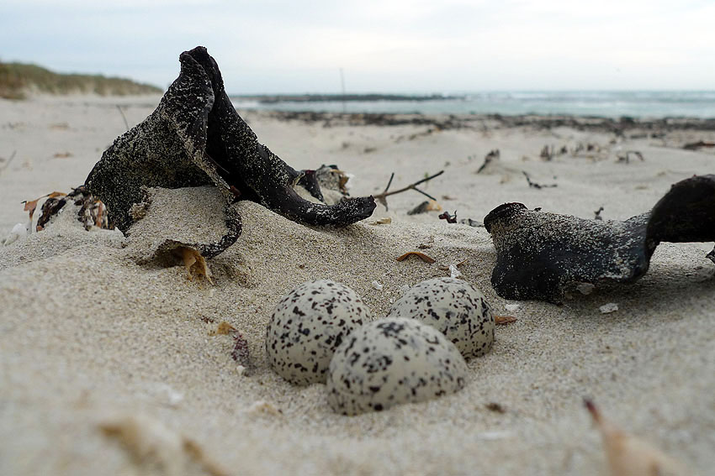
Scrape
Scrape Nests
Positives:
Takes little time
Takes little energy
Negatives:
Easy for predators to access
Not sheltered from weather

Slide 4
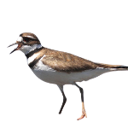
Killdeer
Scrape Nests & Killdeer
In nature:
killdeer nest in places with little or no plants, gravel or rocks
In cities:
Killdeer nest in
parking lots and
rooftops
Killdeer eggs are very well camouflaged due to their spots
Notes:
Killdeer usually nest in open areas with little plants or on a gravel/rocky surfaces. In cities and towns, parking lots and rooftops are some of their favourite nest sites.
Both the males and females building the nest, a simple scrape or shallow depression in the ground. Killdeer line their nest with small rocks, shells, or other objects. Killdeer nests are always well-camouflaged, and the four heavily speckled eggs blend perfectly with their surroundings. Both the male and female take turns incubating the clutch (nest) until their eggs hatch.
Killdeer chicks hatch with their eyes open and covered in downy fluff; they leave the nest almost immediately, attended by their parents.

Slide 5
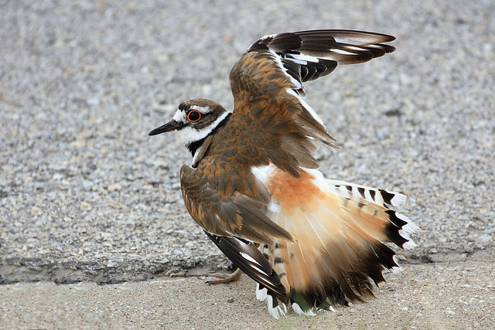
Killdeer
Scrape Nests & Killdeer
Both male and females build the nest and care for nestlings
Killdeer protect their eggs by doing two things
The broken wing dance
The fluff and charge
Click the video
to see!
Notes:
Killdeer perform a "broken wing" distraction display to lead predators away from their nests. To guard against large hoofed animals that might step on their nests, Killdeer use a different display. They fluff themselves up, fanning their tail over their heads, and running at the animal to make it change its path.

Slide 6
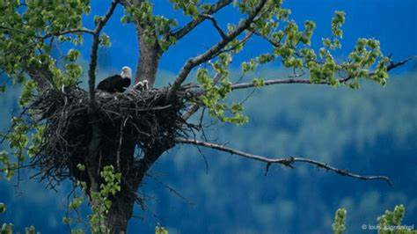
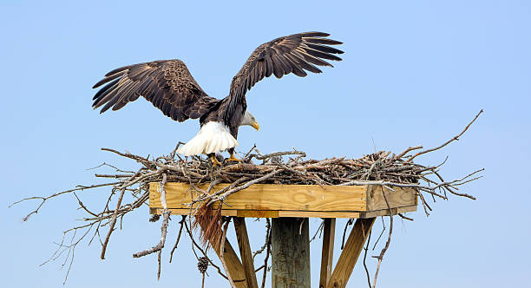
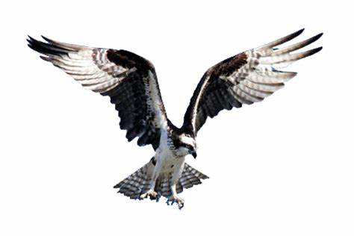
Platform
Platform Nests
Platforms are:
Very large
Built in trees and on the ground
Used year after year by the same birds (usually)
Birds add more materials every year to nest
Notes:
Platform nests are large, flat nests built in trees, on the ground, on the tops of vegetation, or even on debris in shallow water. Many platform nests are reused year after year by the same birds, with additional materials added to the nest with each use. This practice can create huge nests that damage trees—especially in bad weather.
Osprey, mourning doves, egrets, herons, and many raptors are the most common platform nesters. Raptor nests are also called 'eyries,' or 'aeries.'

Slide 7
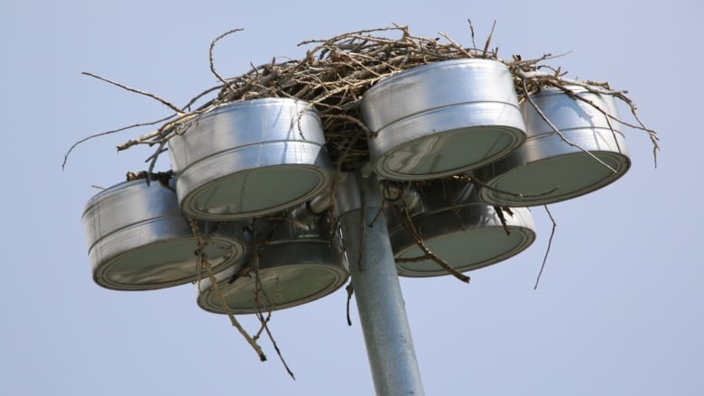
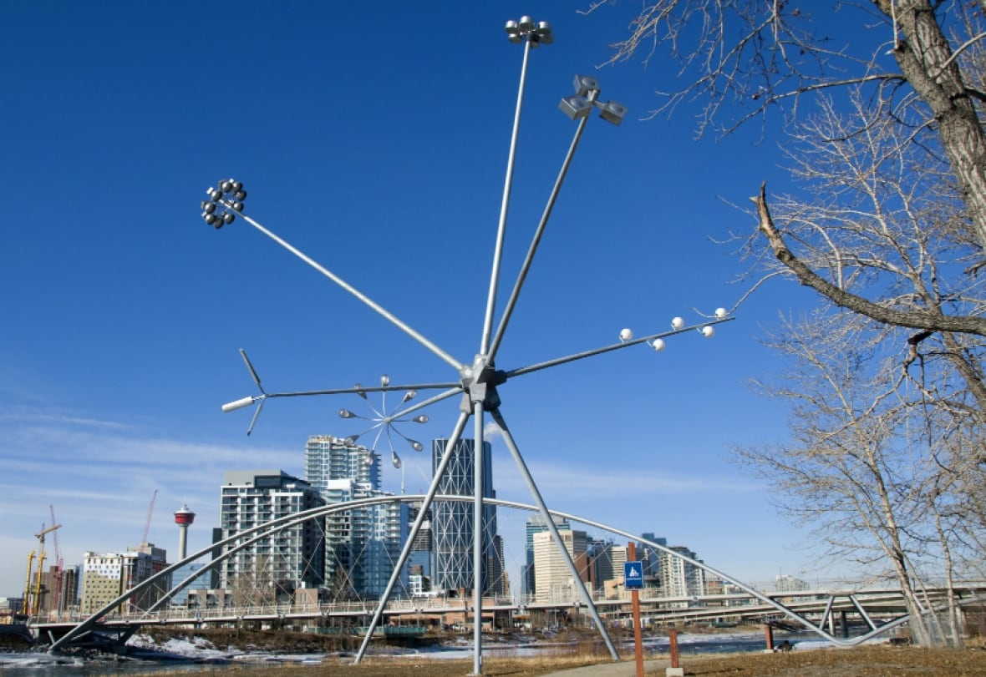
Platform
Platform Nests
Positives:
Hard for some predators to access
Space for the nestlings to grow into fledglings
Negatives:
Takes a long time to build
Takes a lot of energy to build
Can cause some trees to fall down

Slide 8
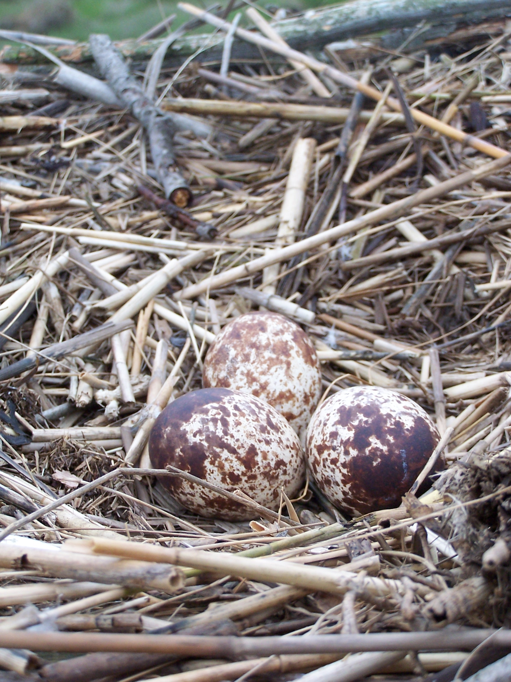
Osprey
Platform Nests & Osprey
In nature:
Osprey will nest on dead or live trees close to water.
In cities:
Osprey will nest on buildings, telephone poles, electrical poles, and man made platforms.
Osprey will protect their nesting sites from other Osprey, chasing them away.
Notes:
Ospreys nest in a wide variety of habitat types. Good nesting sites are emerging dead or live trees or other structures with easy access located near rivers, lakes, bays, reservoirs, lagoons, swamps, and marshes.
Areas near water have become prime real estate reducing the number of available nesting sites. Ospreys now nest on channel markers, communication towers, utility poles. Many people provide nesting platforms, which birds readily take.
Nesting Ospreys defend only the immediate area around their nest rather than a larger territory. They will chase away other Ospreys that encroach on their nesting areas.
An Osprey nest is an untidy platform made of sticks with a central depression lined with smaller sticks, vines, and algae. The same nest is re-used every year and additional material is added resulting in huge nests of up to 11 feet deep and 5 feet in diameter.
An Osprey egg hatches in 36-42 days. Both parents take turns to incubate the eggs.
Ospreys have a fascinating conservation story. Most North American populations experienced a drastic population decline in the early 1950s to 1970s. The cause of this decline was attributed to the use of pesticides, which poisoned the birds, thinned their eggshells, and make nests fail.
The Pesticide DDT was banned in 1972 and marked the beginning of the Osprey population rebound. The widespread construction of artificial platform nests also had a positive impact on the growing populations.

Slide 9
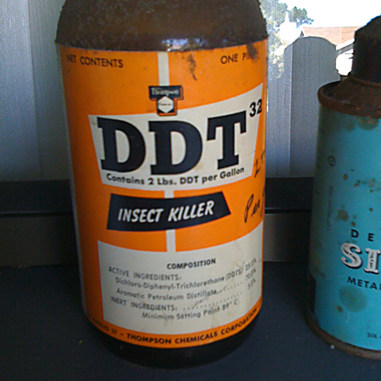
Osprey
Platform Nests & Osprey
Osprey were at risk of extinction in the 1950’s to 1970’s
The pesticide DDT was to blame
DDT was banned (made illegal) in 1972
Because DDT was banned and more man-made Osprey platforms were built, Osprey populations recovered!
Click
to learn more!
Notes:
Ospreys have a fascinating conservation story. Most North American populations experienced a drastic population decline in the early 1950s to 1970s. The cause of this decline was attributed to the use of pesticides, which poisoned the birds, thinned their eggshells, and make nests fail.
The Pesticide DDT was banned in 1972 and marked the beginning of the Osprey population rebound. The widespread construction of artificial platform nests also had a positive impact on the growing populations.

Slide 10
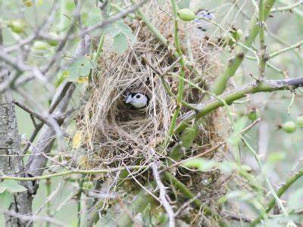
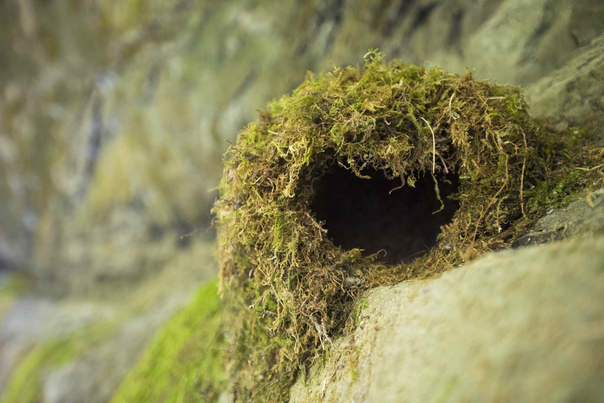
Dome
Dome Nests
Dome nests are:
A spherical (circular) nest
Has an entrance hole
Commonly made in thick bushes
Notes:
Another common nest structure is the domed nest, which is spherical or bottle-shaped with an entrance on the side. Birds like finches, thornbills, and fairy-wrens build these kinds of nests, and they can be commonly found in dense shrubs.

Slide 11
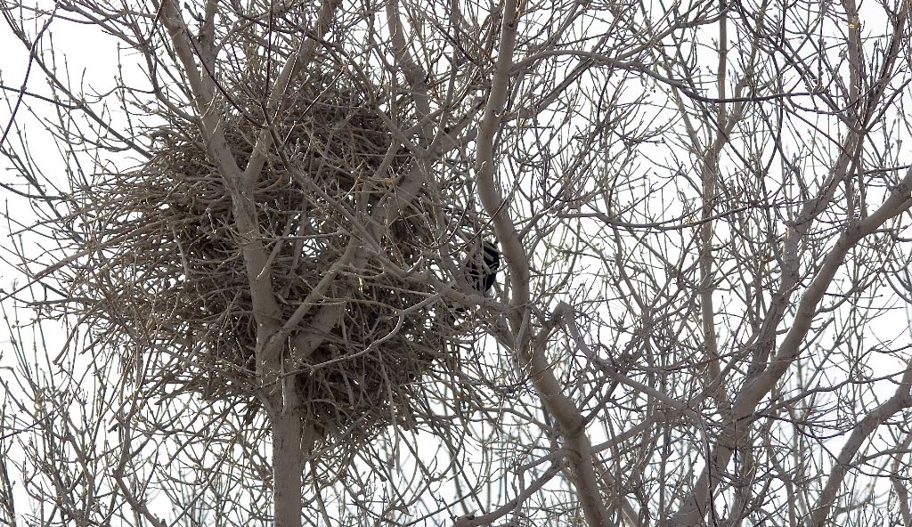
Dome
Dome Nests
Positives:
Hard for some predators to access
Sheltered from weather
Negatives:
Takes a long time to build
Takes a lot of energy to build

Slide 12
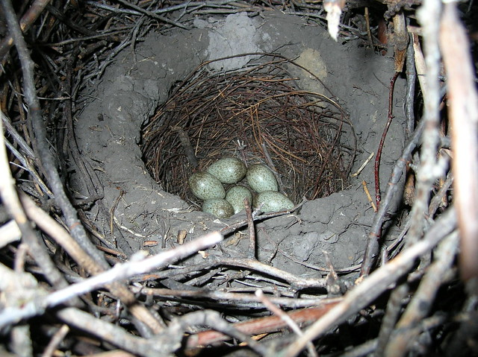
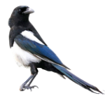
Magpies
Dome Nests & Black-billed Magpies
Nest in dense trees or shrubs to protect against predators.
Males and females build the nest together with the males building the outside and females building the inside.
Magpie nests have an exit and entrance because their long tails prevents them from turning around in their nests.
Nests take 40-50 days to build.
Notes:
Both sexes seem to choose a nesting site together (though sometimes they disagree and each begin building separate nests in different locations). They build their dome nests in conifer trees, deciduous trees, shrubs, utility poles, and even in deserted buildings. They will nest in open woodlands, riparian thickets, farm fields, and suburban areas.
Black-billed Magpie pairs share the work of building their domed nests, which vary widely in size but are typically about 30 inches high and 20 inches wide. The male gathers sticks for the exterior. The female tends to the interior, forming a mud cup and lining it with grass.
Black-billed magpies build their nests over 40-50 days. They can repair old nests and use them, or they can build a new nest on top; older nests thus may reach 120 cm high by 100 cm wide (48 inches high by 40 inches wide). Black-billed magpies are known to make food caches in the ground, in a scatter-hoarding fashion.

Slide 13
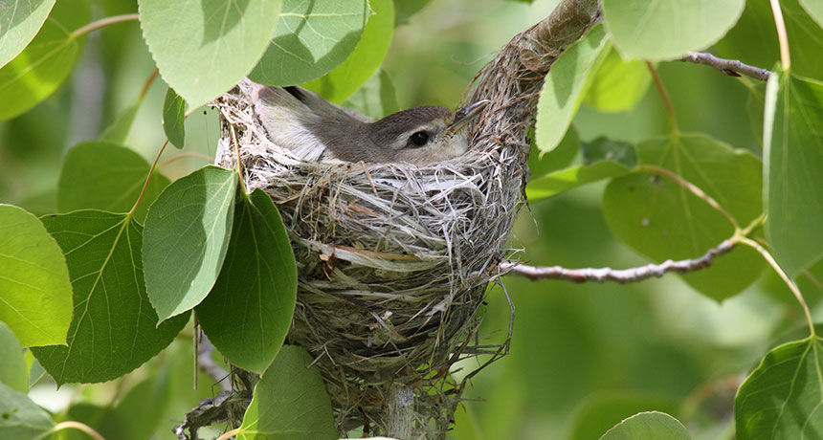
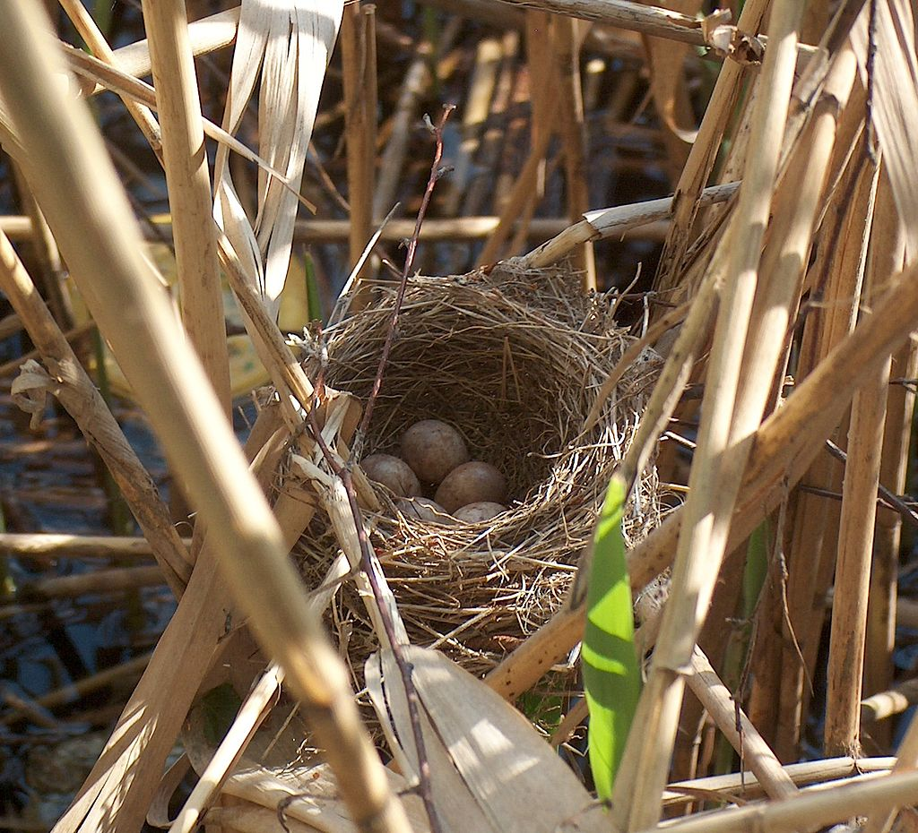
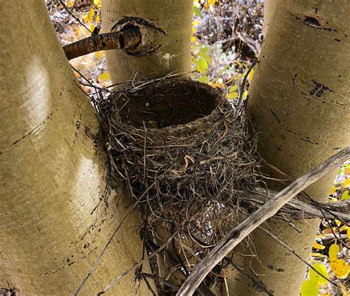
Cup
Cup Nests
Cups are:
Cup-shaped
One of the most familiar nest types
Built often in trees on branches or natural ledges
Made out of grasses, sticks, spider webs, moss, mud and more
Notes:
As their name implies, cup—or cupped—nests are in fact cup-shaped. They are usually rounded with a deep depression in the center to house the eggs and chicks.
Hummingbirds, some flycatchers, swallows, and swifts, kinglets, vireos, crests, and some warblers are some of the birds that utilize this common nest shape.
Cupped nests are usually made with dried grasses and twigs that are stuck together using globs of saliva. Mud and spider webs may be used as well.
A simple cup-shaped nest is the most familiar, common nest type. The overall size, dimensions, and depth of the cup may differ, and some birds build distinct inner and outer cup layers. Cups are often positioned along tree branches or in tree forks or may be nestled on ledges or in any number of unique places.

Slide 14
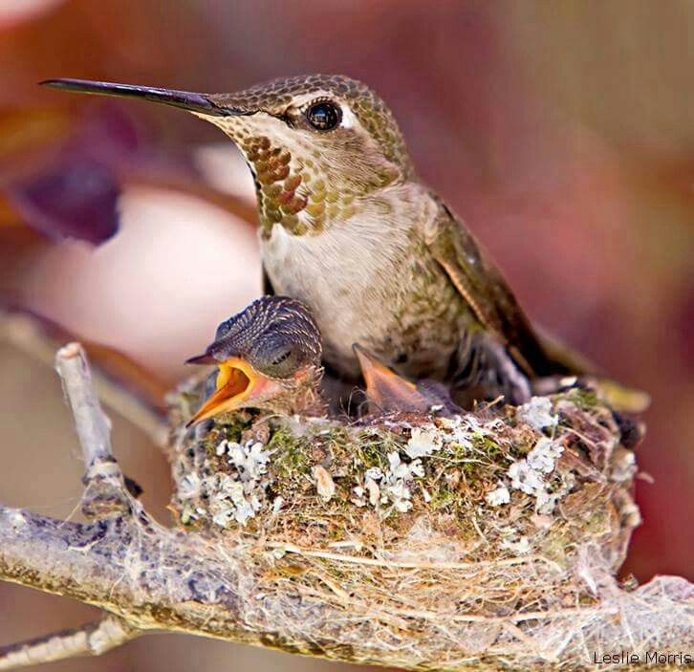
Cup
Cup Nests
Positives:
Easy to build in many places
Eggs are insulated and protected in the bottom
Negatives:
Open access for predators

Slide 15
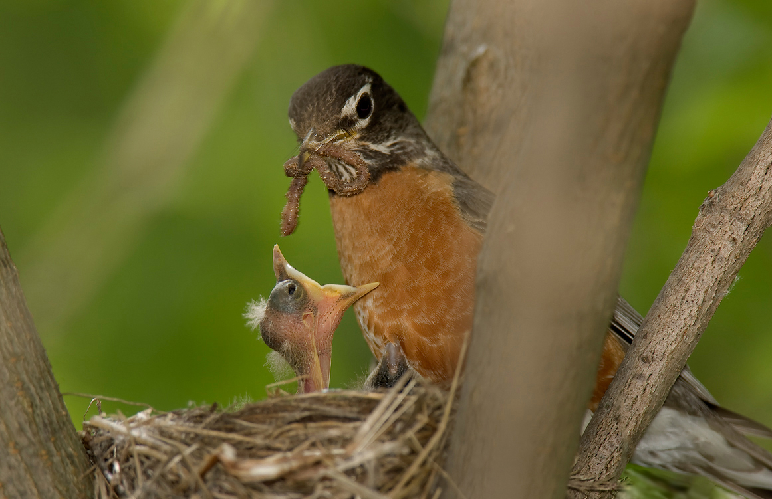
American Robin
Cup Nests & American Robin
Males and females build the nest together
Males bring females material while she builds
Mud is important to a robin’s nest
In cities, robins will nest on buildings, in garden boxes and windowsills
Click to see the video
Notes:
In a robin couple, a male robin brings his female partner nesting material as she constructs the nest. The female builds the cup-like nest with mud as its foundation and lines it with grasses, twigs and other plant material.
Mud is an essential part of robin nest architecture. The foundation is constructed of mud that holds the nest together like cement. The mud is typically gathered from a ready source, such as the edge of a puddle or earthworm castings. In drier years, robins have to be more resourceful and manufacture their own mud. They’ve been observed carrying dirt in their bills to a birdbath to soak, and splashing in a birdbath before flying to a spot of dust and shaking the water off. There’s a good chance that the birds you observed were soaking nest material to make mud.
They build cup shaped nests on branches or ledges. Robins will also happily nest in planters, on windowsills, and in other nooks and crannies around a building. The birds may use flower petals or scraps of paper, string, or cloth on the outside of the nest. It may look like they are simply decorating, but these things serve as camouflage by breaking up the dark outline of the nest, helping it to blend in better with the patchy light and shadow in a tree.

Slide 16
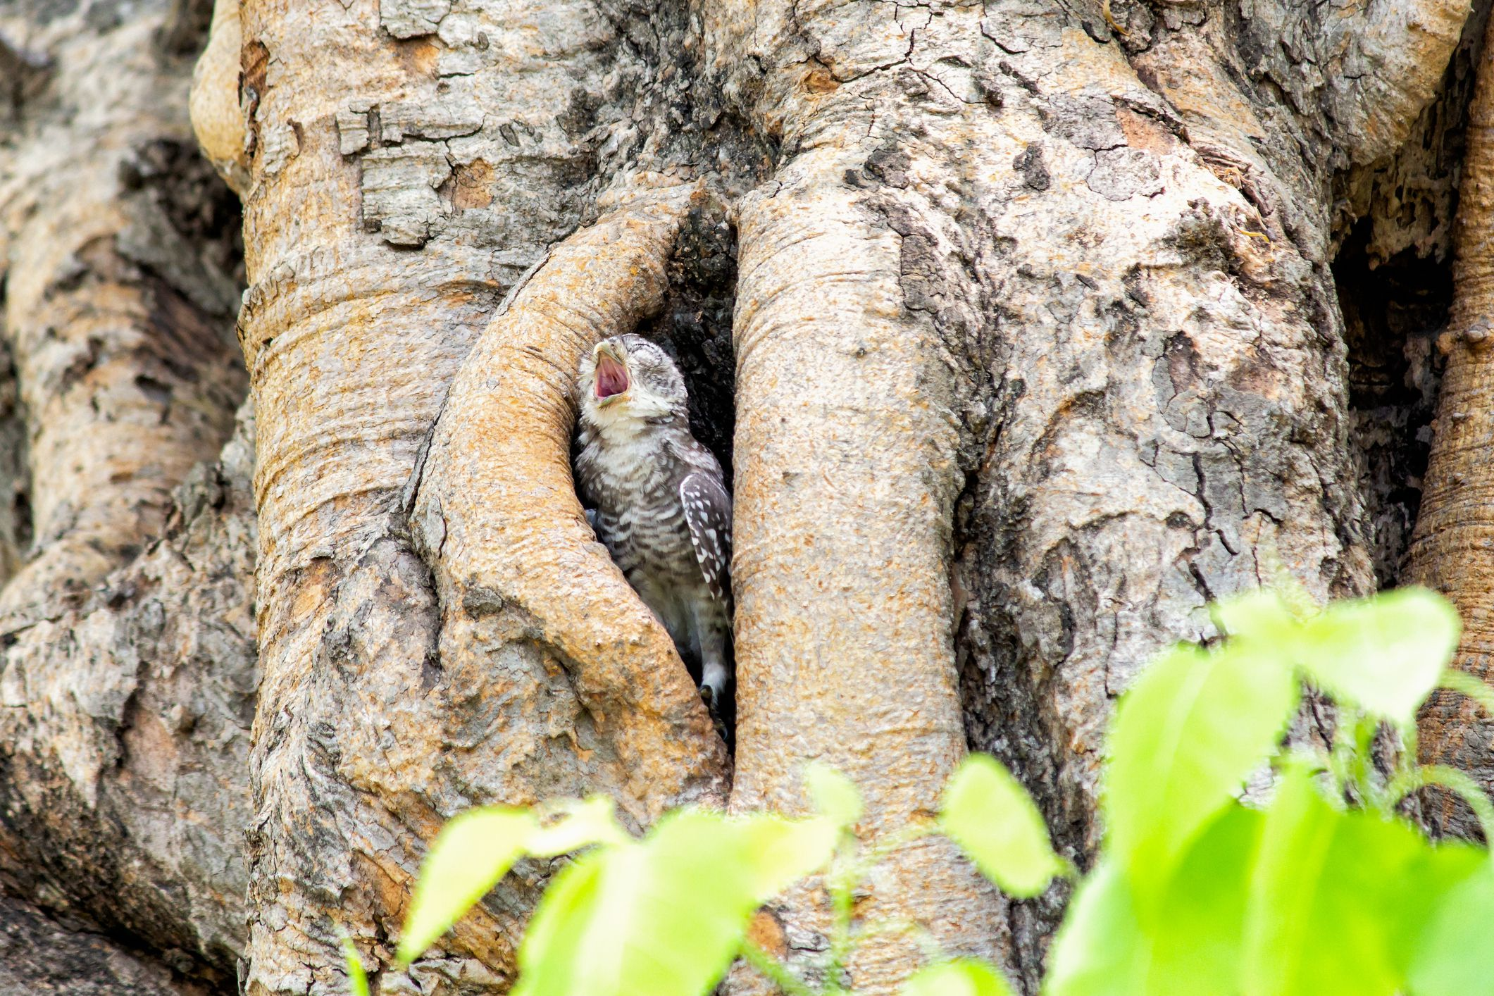
Cavity
Cavity Nests
Cavity nests are:
Build nest in an existing object/shelter
Holes either made by the bird or found by the bird
Found in trees, river banks, the ground, rocks, birdhouses, or even buildings.
Notes:
There are 85 species of birds that are classified as cavity nesting birds. Familiar examples include many woodpeckers, chickadees, parrots, nuthatches, trogons, flycatchers, wrens and bluebirds. Some ducks, such as the mandarin duck and wood duck, nest in cavities, as do some of the smaller raptors and owls. The American kestrel, barn owl, purple martin, great tit, and European robin are all common cavity-nesters.
The size, shape, and placement of cavities vary depending on the bird species and their individual nesting needs.
Cavity birds use: stone walls and natural cliffs, rock crevices, holes in logs and tree stumps, holes in a dead or decaying tree, burrows in dirt mounds, burrows in soft riverbanks and dunes, and exposed chimneys and pipes.
Some birds use a bare, empty chamber, while others line the floor or interior of the chamber with grass, twigs, wood chips, feathers, fur or other materials, even creating an entire nest within the chamber.
There are two types of cavity nesting birds. Primary and secondary.
Primary cavity-nesting birds: These birds excavate their own holes, such as woodpeckers that drill out chambers in suitable trees or ground-nesting species that may dig out burrows in riverbanks. The labor to create a new cavity may take several days or weeks, depending on the birds' nesting needs.
Secondary cavity-nesting birds: These species take advantage of natural or abandoned cavities, or in some cases will usurp them from other birds through aggressive intrusion. They may make minor adjustments to the cavity, such as adding or removing nesting material or changing the entrance but do not do substantial modifications.

Slide 17
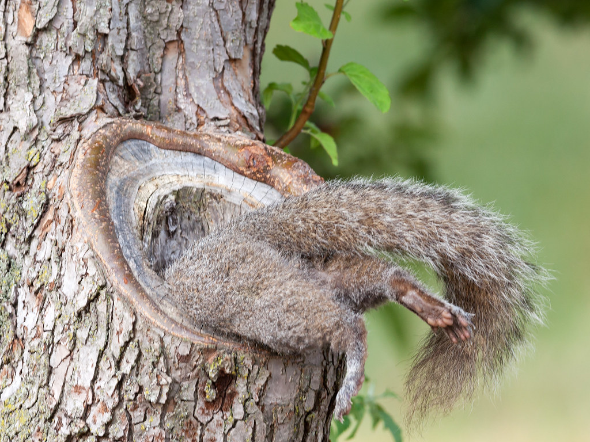
Cavity
Cavity Nests
Positives:
Easy to create if finding
Sheltered from weather
Negatives:
Costs time and energy when building
No escape route should a predator come
Click
to learn how to protect cavity nests from predators!
Notes:
Backyard birders can attract these birds by offering suitable nesting sites. Leaving old trees and dead snags available for primary cavity nesters can be successful, and adding birdhouses or nest boxes will help attract many secondary cavity nesters. Providing nesting materials for birds in spring will also encourage nesting activity nearby.
Like other nesting birds, cavity-nesting birds face the dangers of predators. Predators can access their nests inside trees, rock crevices, or stone walls, catching them and their young inside with no way to escape. Some species have their own way of lowering the chance of a predator getting into their nest.
It may be small, but the red-breasted nuthatch is mighty in its determination to protect its young. This species smears sap around the entrance holes of its nest. The white-breasted nuthatch, the larger of the two species, rubs foul smelling insects around the entrance hole of its nest. The red-cockaded woodpecker drills wells above and below nesting holes that allows tree resin to flow, preventing snakes from reaching its nest.

Slide 18
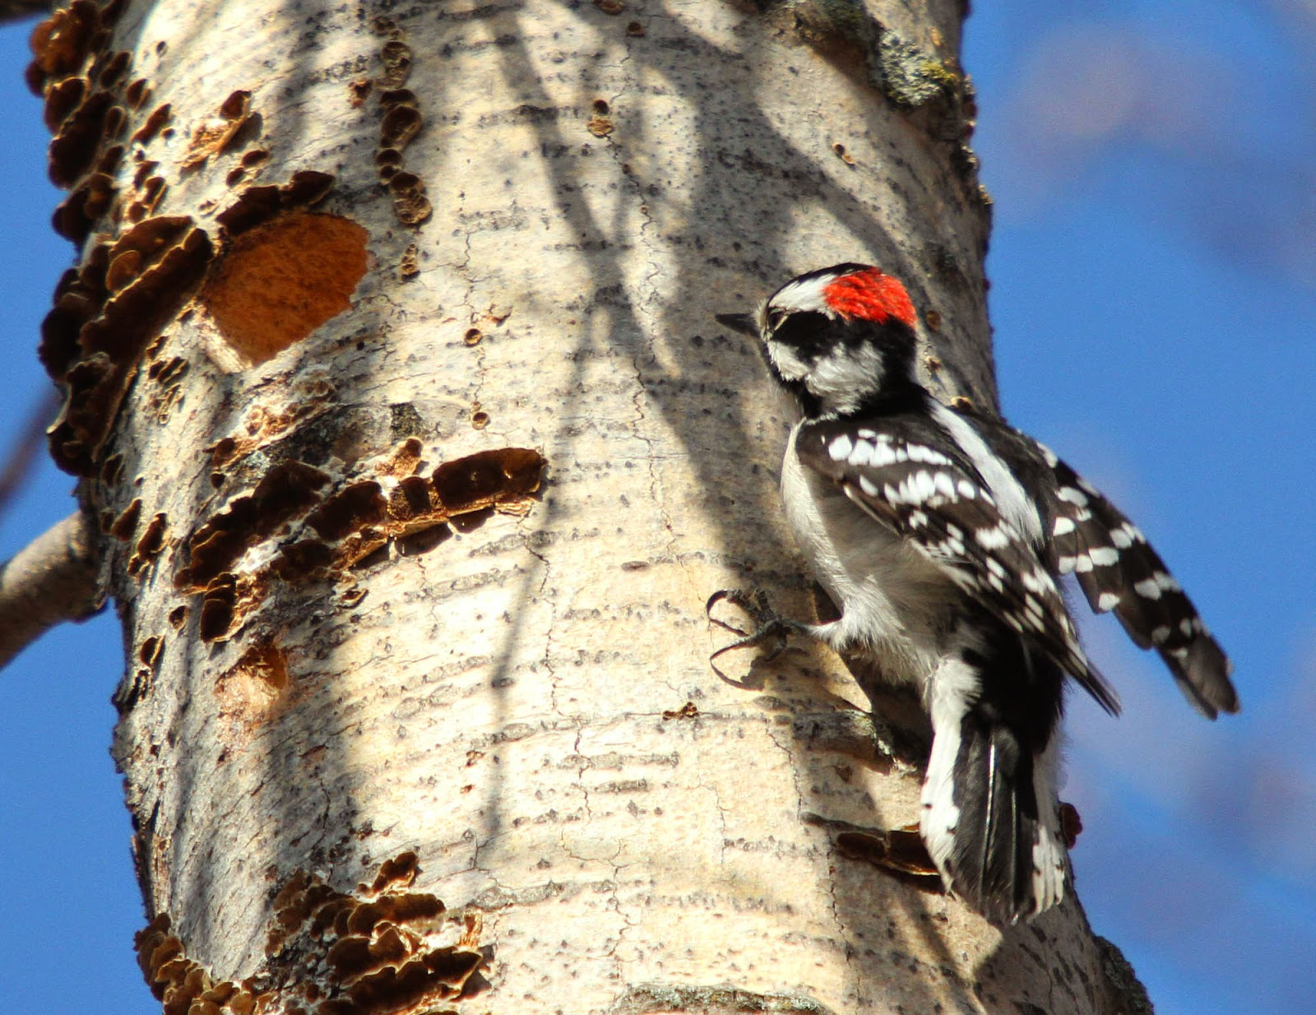
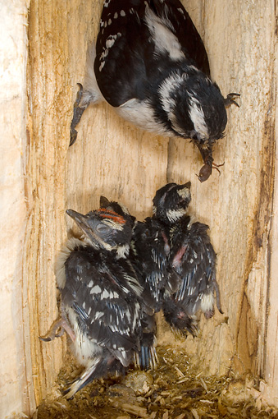
Downy
Cavity Nests & Downy Woodpeckers
Nest in dead trees or dead parts of a living tree
Males and females create the cavity
Building the nest takes 1 to 3 weeks
They prefer trees over manmade bird houses
Males and females will incubate (sit on) the eggs
Notes:
Downy Woodpeckers nest in dead trees or in dead parts of live trees. They typically choose a small stub (averaging around 7 inches in diameter) that leans away from the vertical, and place the entrance hole on the underside. Nest trees are often deciduous and the wood is often infected with a fungus that softens the wood, making excavating easier.
Both male and female excavate the nest hole, a job that takes 1 to 3 weeks. Entrance holes are round and 1-1.5 inches across. Cavities are 6-12 inches deep and widen toward the bottom to make room for eggs and the incubating bird. The cavity is lined only with wood chips.

Slide 19
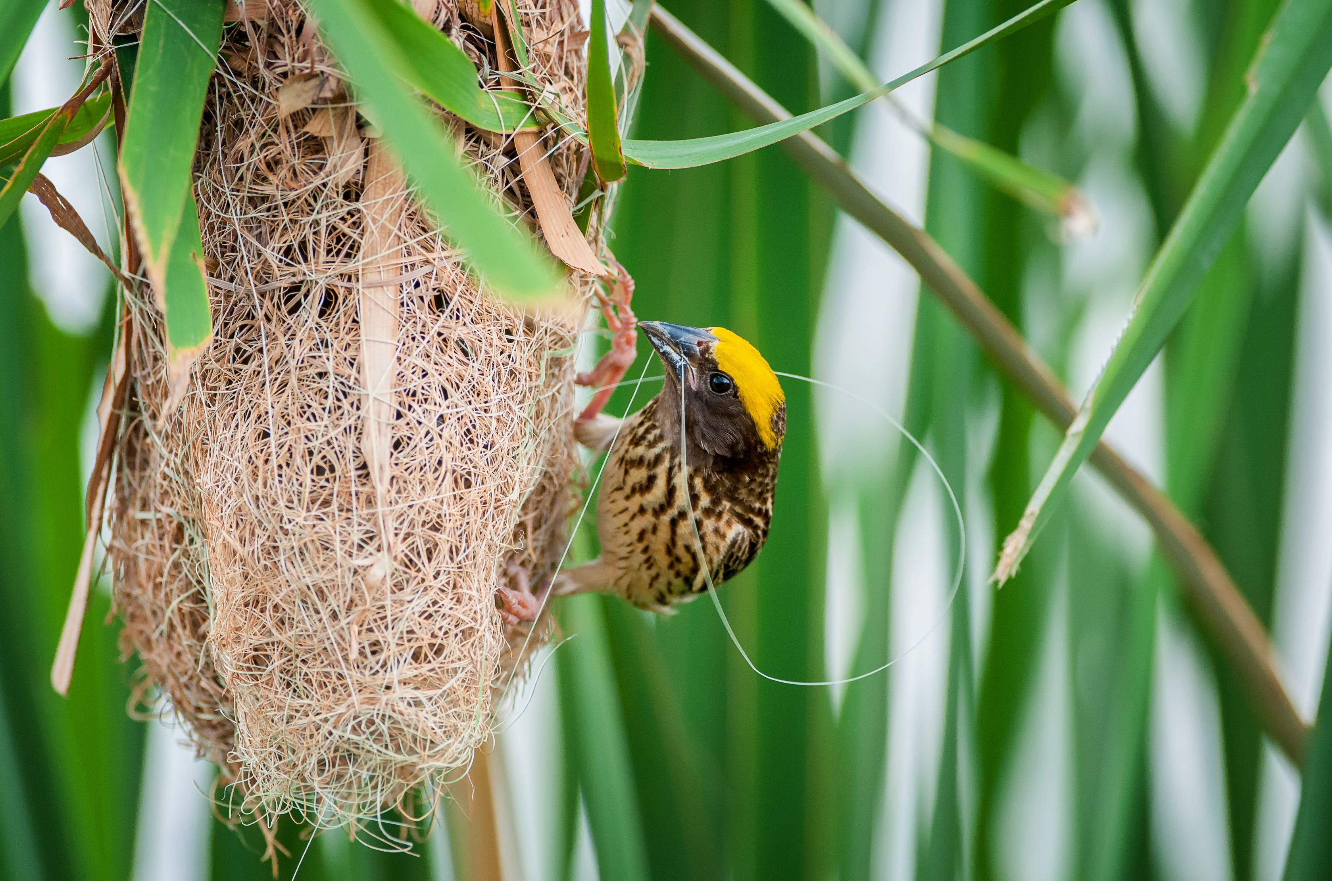
Pendant
Pendant Nests
Pendant nests are:
Woven baskets built every year by birds
Built from branches on trees
Materials include grasses or very thin twigs
Good protection from predators as it is not on a branch where others can perch

Slide 20
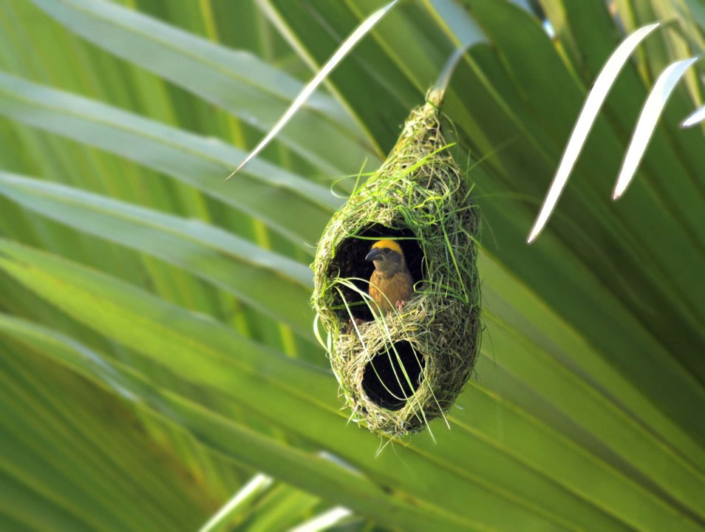
Pendant
Pendant Nests
Positives:
Building materials are easy to find
Surprisingly strong and stable
Negatives:
Costs time and energy when building
Click
to see a weaver bird build their nest!
Notes:
Pendant nesters created an elongated sac suspended from a tree branch and made from pliable materials, such as grasses or very thin twigs, to house their young. Weavers, Orioles, sunbirds, and caciques are common pendant nesters.
Pendant nests are elaborately woven sacks that dangle from branches, giving birds in the nest great protection from predators. Some are not suspended very far from the branches while others may hang several feet below their attachment point. Birds enter the nest through an entrance on the side.

Slide 21
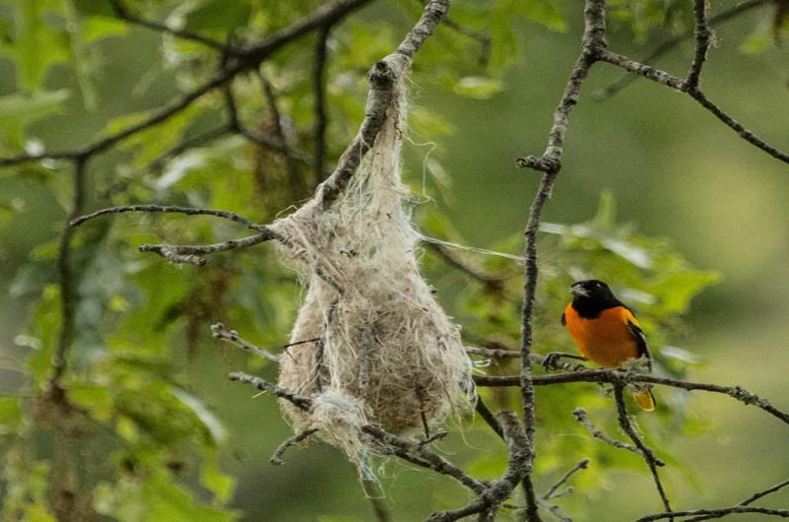
Baltimore
Pendant Nests & Baltimore Orioles
Females build the nest
Females choose materials close to nest site
Will build a new nest every year
The nest is completed in roughly one week
Click
to see a Baltimore Oriole and nestlings
Notes:
How Orioles Build Those Incredible Hanging Nests | Audubon

Slide 22

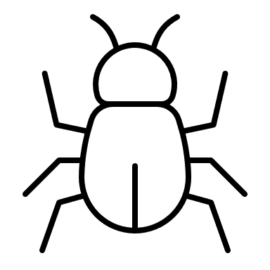


Thank you!

