Slide 1
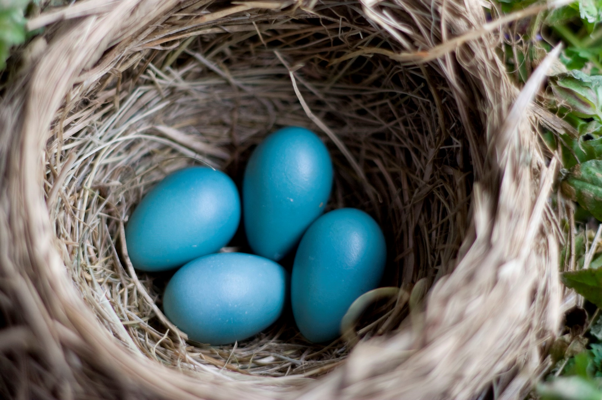
Notes:
American Robin, Egg

Slide 2
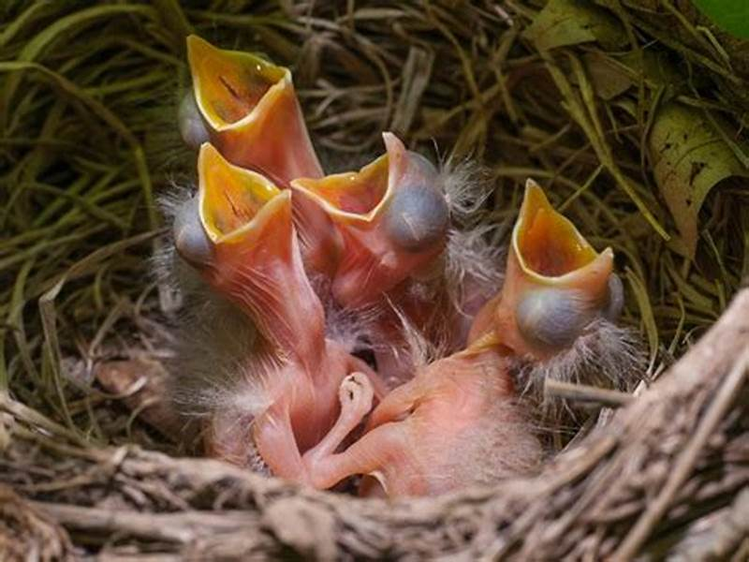
Notes:
American Robin, Nestling

Slide 3
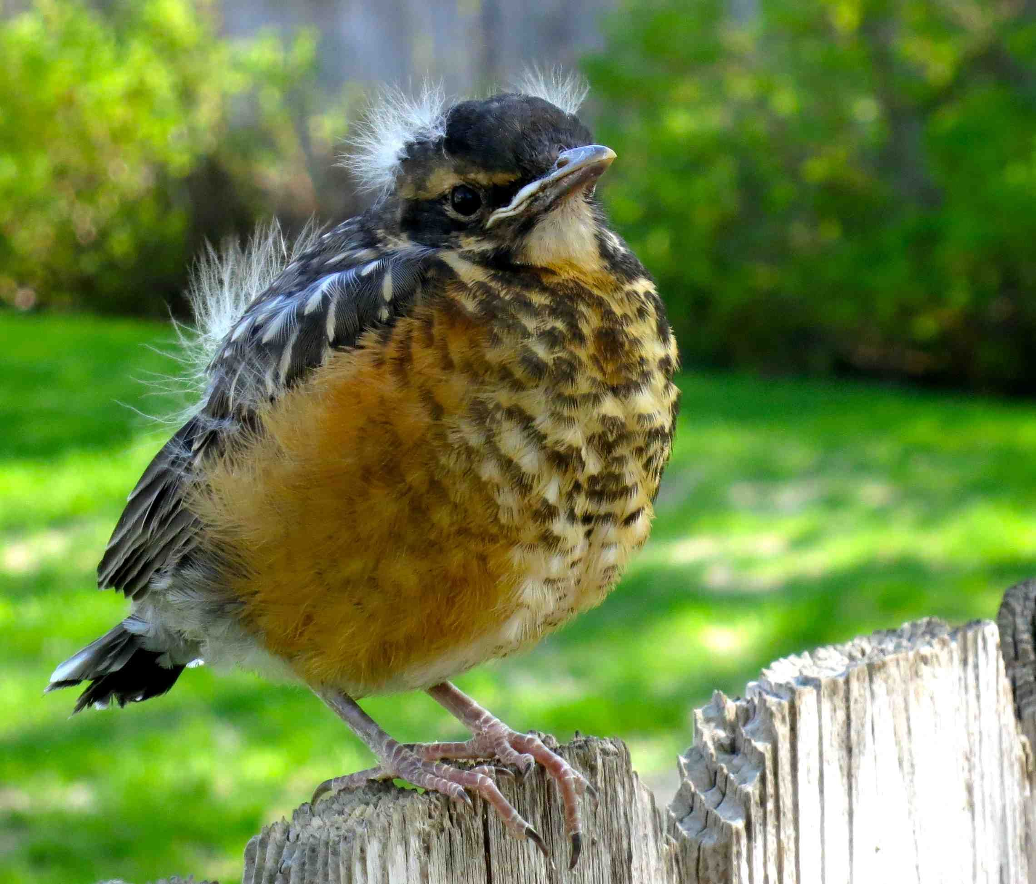
Notes:
American Robin, Fledgling

Slide 4
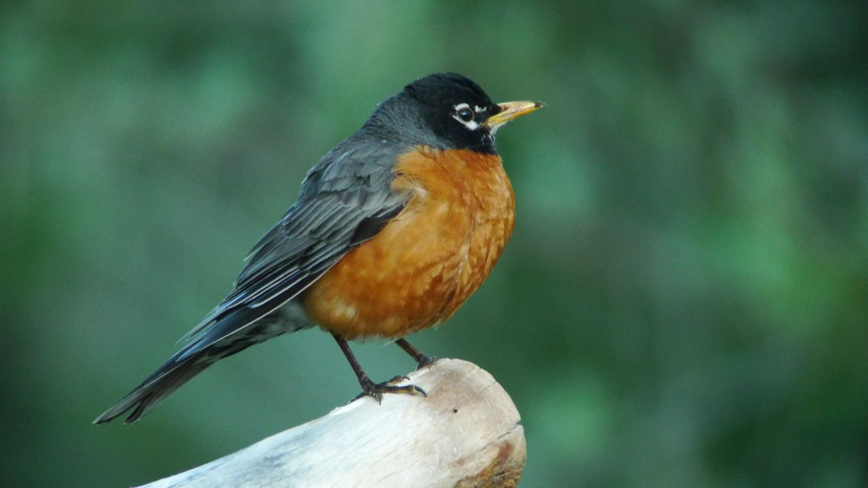
Notes:
American Robin, Adult

