Slide 1


YYC Young Citizen Scientists
Tree Growth Patterns

Slide 2
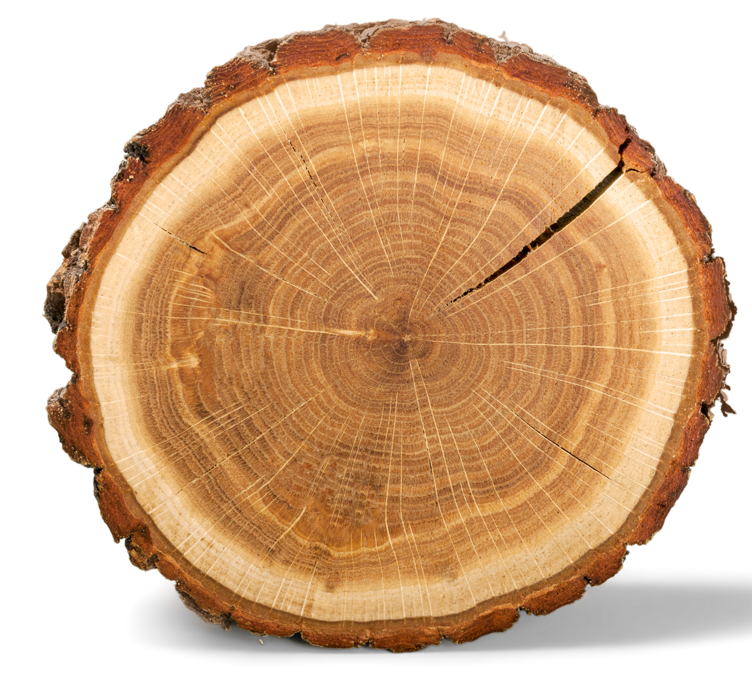
Reading Tree Cookies
Outer bark
Phloem or inner bark
Cambium
Sapwood or xylem
Growth ring
Heartwood
Notes:
There are many important parts of the tree cookie that tell us information about the tree! Here we see the different parts of the tree cookie which we will try to find on our own tree cookies today.
Outer bark: the outer most layer that protects the inner layers of the tree. The bark prevents moisture loss from the tree, limits insect or pest infestations to the inner layers, and protects the inner layers from changes in temperature (too hot or too cold).
Phloem/inner bark: act as the food transport within the tree! Phloem transports food and nutrients from the leaves to the rest of the tree for growth.
Cambium: This is where the magic happens – here is where the tree develops new cells for growth. These new cells allow the trunk, branches, and roots to grow bigger and thicker.
Sapwood or xylem: This is where the main transport for water and sap occurs from the roots to the leaves.
Growth ring: these are the rings we see branching out from the centre all the way out to the outer bark. Each ring represents one year of life. Within each ring we will see the lighter portion which is called the “early wood” because it grows in the spring. The darker portion is called the “late wood” because it grows in the summer.
Heartwood: At the very centre of the tree cookie, we find the heartwood which is old, dark sapwood that is no longer carrying sap or water. This portion of the tree is actually dead but provides stiffness and support to the trunk of the tree.
https://www.idahoforests.org/content-item/tree-cookies/

Slide 3
Reading Tree Cookies
How do we read tree age with tree cookies?
What influences the rings and tree growth?
Notes:
How do we read tree age with tree cookies?
To determine the age of a tree, we can count the growth rings! Each ring represents one year of life for that tree, meaning the number of rings tells us how many years old it is! Lets give this a try with our tree rings!
You may notice on your tree ring (or in this photo) some growth rings look thicker or thinner than others. Why is that? What influences the rings and tree growth? (ask for student input)
Thicker growth rings tell us that year had ideal growth conditions for that tree. During that year, the tree was receiving enough of its needs to support fast growth! This usually means the temperatures were warm with no extreme fluctuations, and that they had enough water and sunlight. If the rings are thinner, this tells us the tree did not have sufficient sunlight, water or that the temperature was too hot or cold for growth.

Slide 4
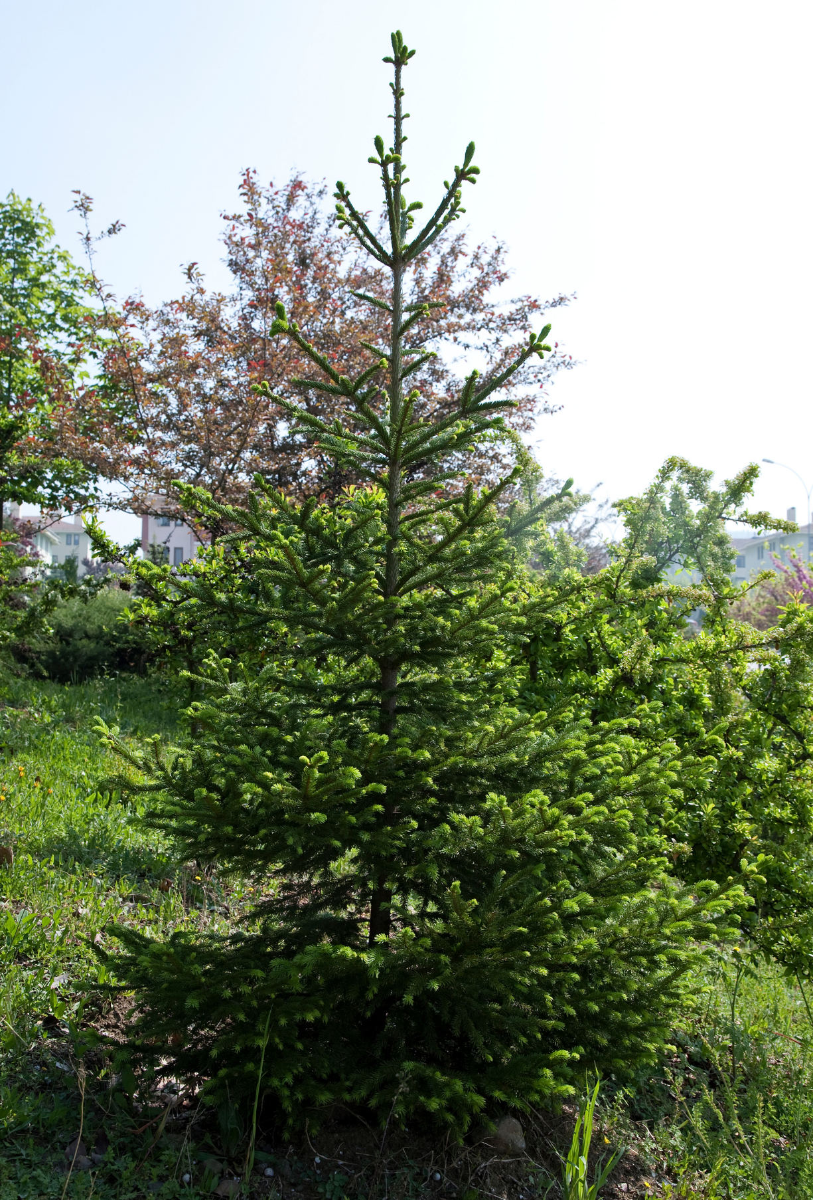
How old?
whorl
whorl
whorl
whorl
Notes:
There are other ways we can determine tree age!
Counting whorls: On coniferous trees, branches grow out in the form of ‘whorls’. A whorl is the circle or row of branches around the tree trunk, the number of whorls represents the number of trees. Starting at the top of the tree, we can count down the whorls to determine it’s age.
https://open.alberta.ca/dataset/448abc96-2efd-4ca3-95d1-1c8a265984d8/resource/15f9fc8c-2d86-4f30-ac77-aca08cd3a8c9/download/2004-envirokids-investigate-forest-health-teachers-guide-grade-6-7.pdf
Page 6

Slide 5
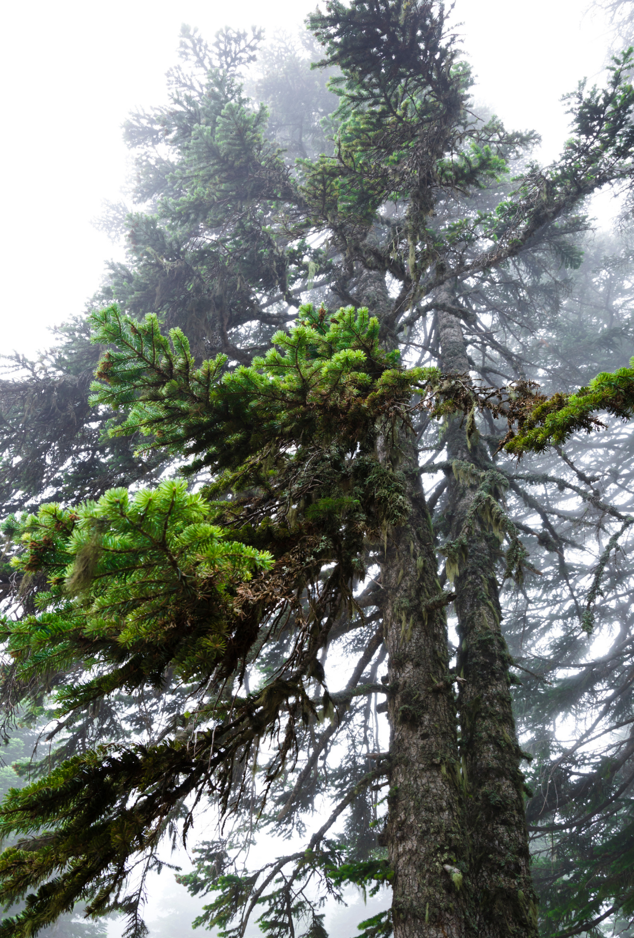
How old?
Notes:
Find better old growth tree pic?
There are other ways we can determine tree age!
Observing colour: Changes in colour can tell us about the age of a tree. Newer bark growth is usually lighter than the rest of the tree and its branches. This can be helpful in a situation where this a group of trees. What’re the differences between these trees? Which one is younger?
The left tree is younger than the right. If you look closely on the younger tree, the new growth buds on the tips of the branches are a lighter green! Similarly, the bark is usually lighter in appearance in younger trees.

Slide 6
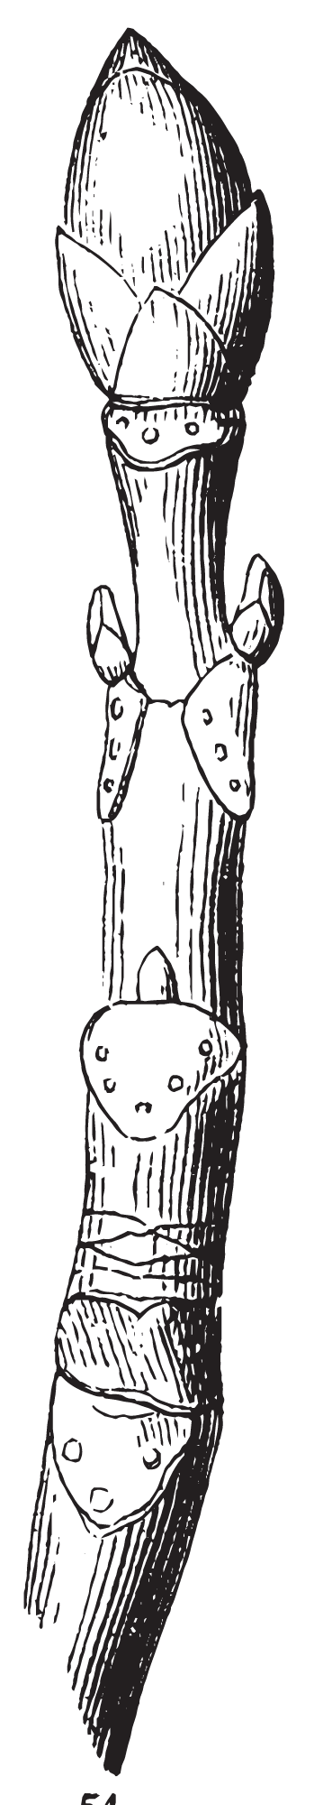
How old?
Terminal bud
Lateral bud
Bud scale scar
Terminal bud scale scar
Notes:
Counting branch scars or markings: every year in the Spring, tree buds swell causing the casing surrounding that bud to fall off. When these casings, or scales, fall off they leave behind a scar on the tree branch under the new buds. We can count the terminal bud scale scars present on the branch to determine the approximate age of that branch in years. To get the age of the tree, we will look for the thickest branch near the bottom of the tree (the oldest branch) and count the terminal bud scale scars for its age in years.
The terminal bud is the on the tip of the branch and is the newest bud to grow. These buds make the twigs grow longer and there is only one the grows per year. The lateral buds are along the side of branches and there are usually several, these buds allow side branches to form. Terminal bud scale scars are the scars remaining from when the previous terminal bud scales.

Slide 7

Debrief
What were advantages and disadvantages of each method used to determine tree age today?
- Tree rings
- Counting whorls
- Colour
- Counting terminal bud scale scars
2. What were some major differences we noticed between old and young trees today?
Notes:
Add questions here for debrief session

