Slide 1
https://www.qrcode-monkey.com/
Print from slide 19 onwards!
Pollinators |  | Birds |  | Urban Wildlife
Grade 3 | Grade 6 | Grade 3 | Grade 6 | Grade 7 | Grade 9
Caterpillar | Caterpillar | Mallard ducks | Mallard ducks | Mallard ducks | Mallard ducks
Red winged black bird | Red winged black bird | Red winged blackbird | Red winged blackbird | Red winged blackbird | Red winged black bird
Butterfly eggs | Butterfly eggs | Black-capped chickadee | Black-capped chickadee | Coyote | Coyote
Black-capped chickadee | Black-capped chickadee | Canada goose | Canada goose | White tailed Deer | White tailed Deer
Red winged black bird | Canadian Tiger Swallowtail butterfly | Canada goose with chicks | Canada goose with chicks | Squirrel | Squirrel
Tri-coloured bumble bee | Tri-coloured bumble bee | American robin | American robin | Prairie crocus | Prairie crocus
Canadian Tiger Swallowtail butterfly | Red winged blackbird | Bird egg | Pileated Woodpecker | Tri-coloured bumble bee | Tri-coloured bumble bee
Note: the QR codes contain a range of species for students to identify. Some will be harder to identify than others; preparing students for the practical citizen science sessions.

Slide 2
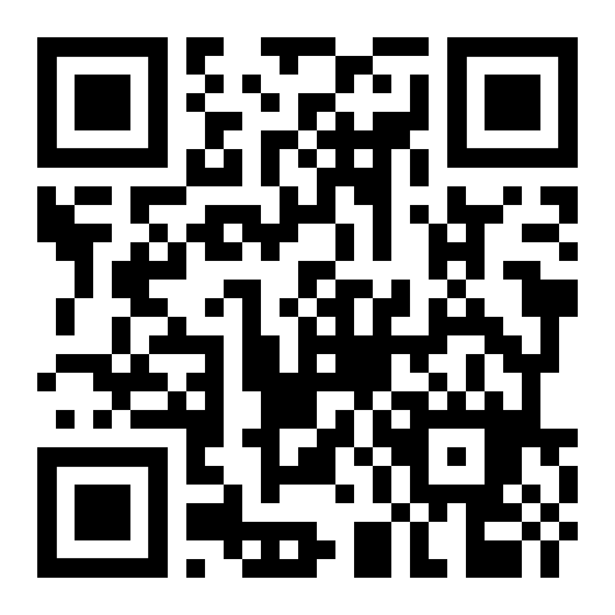
Species: red winged black bird video
https://youtu.be/zhcH7a_gDZA

Slide 3
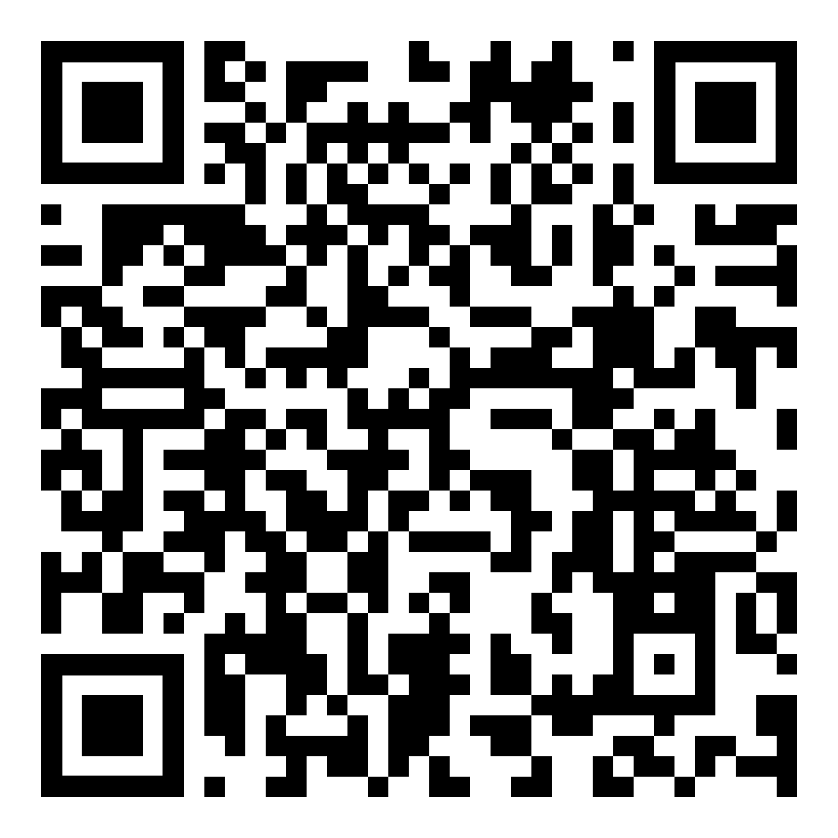
Species: red winged black bird photos

Slide 4
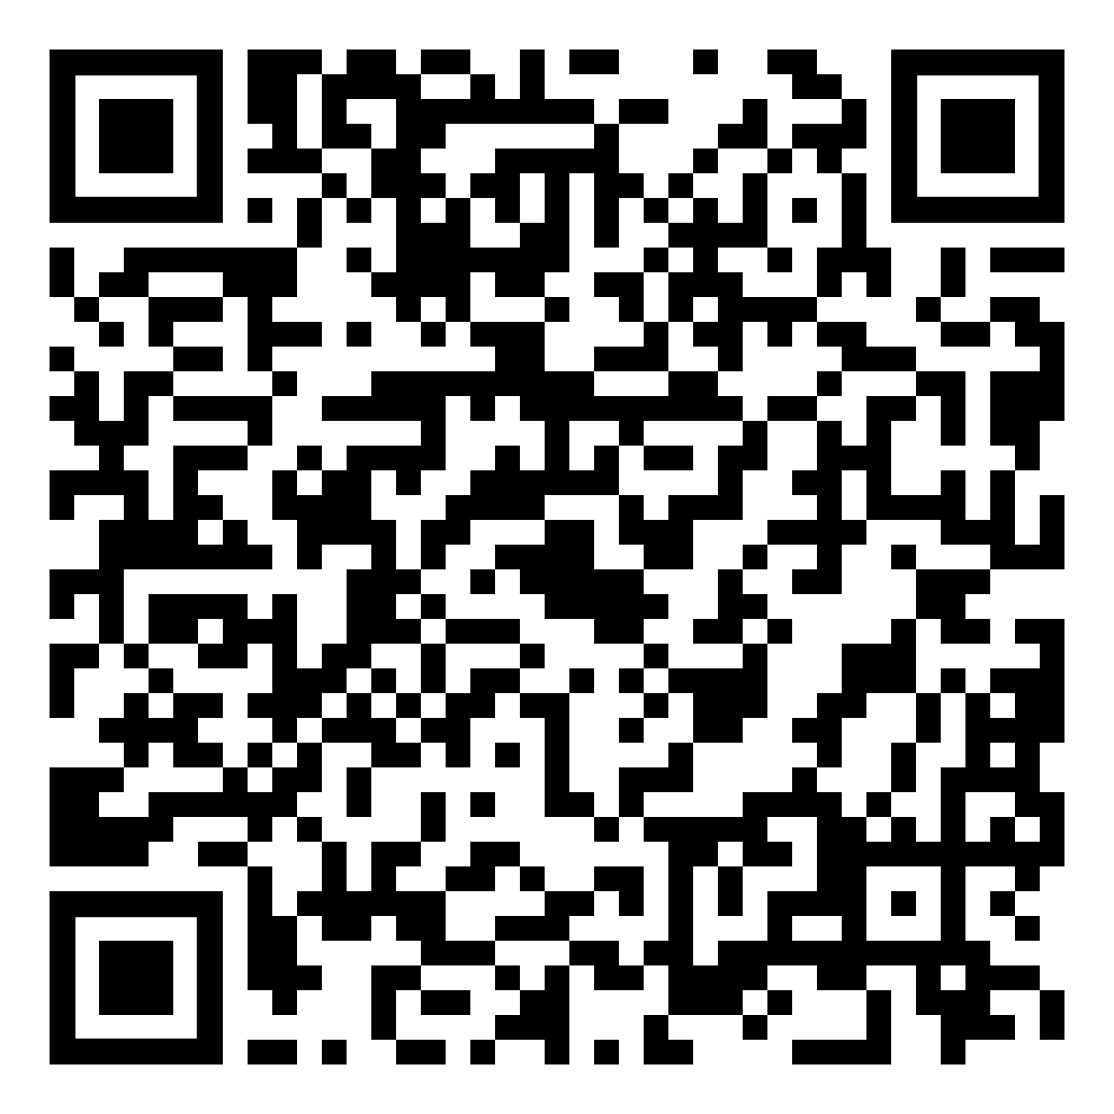
Species: butterfly eggs

Slide 5
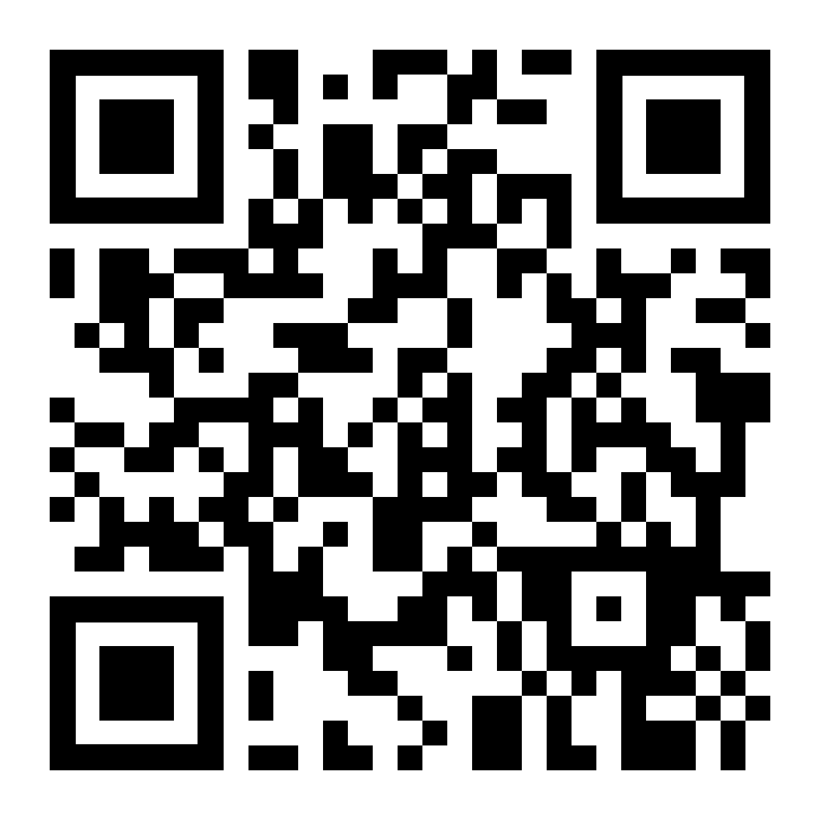
Species: woodpecker

Slide 6
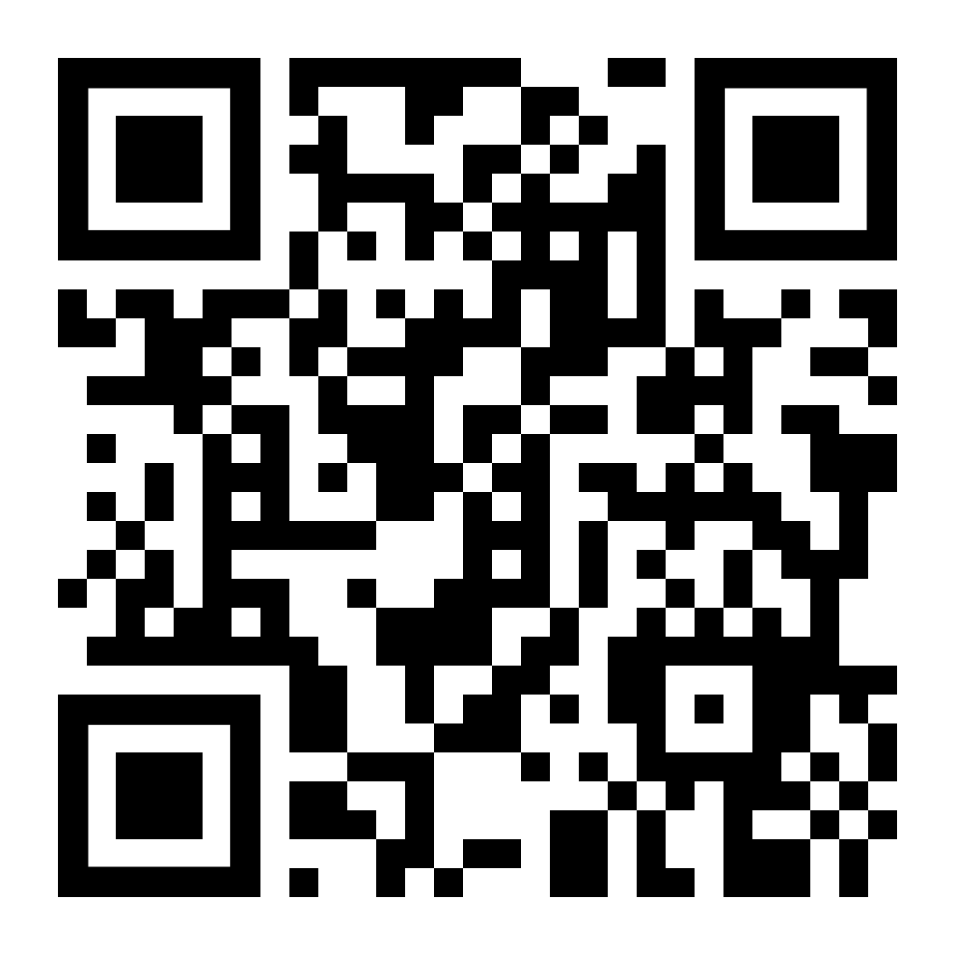
Species: Canada goose video

Slide 7
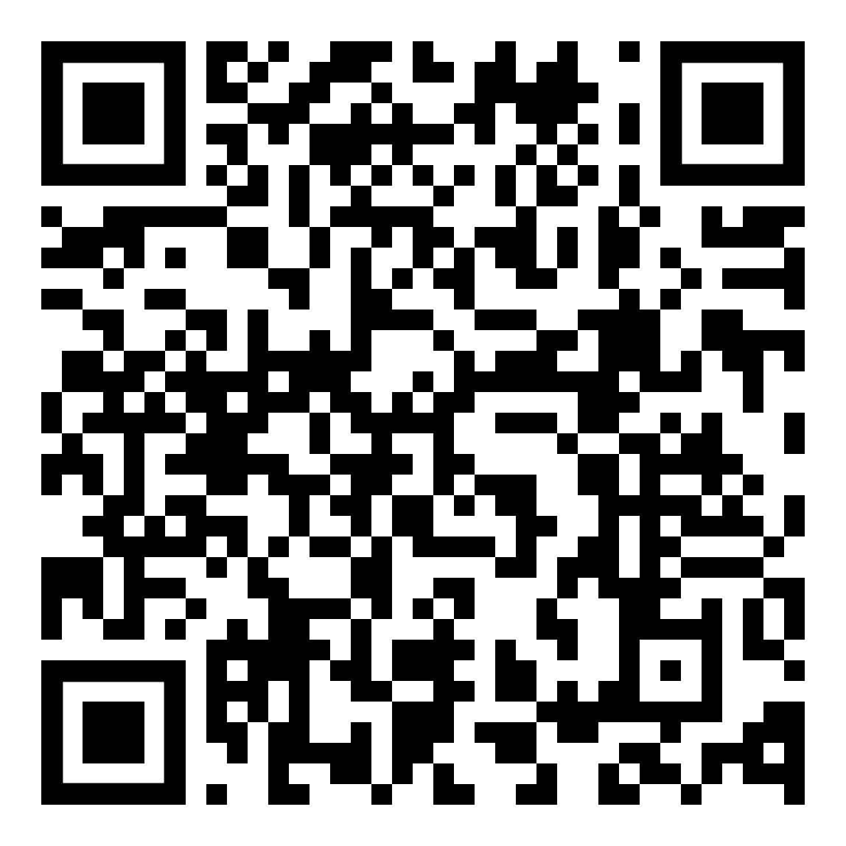
Species: butterfly

Slide 8
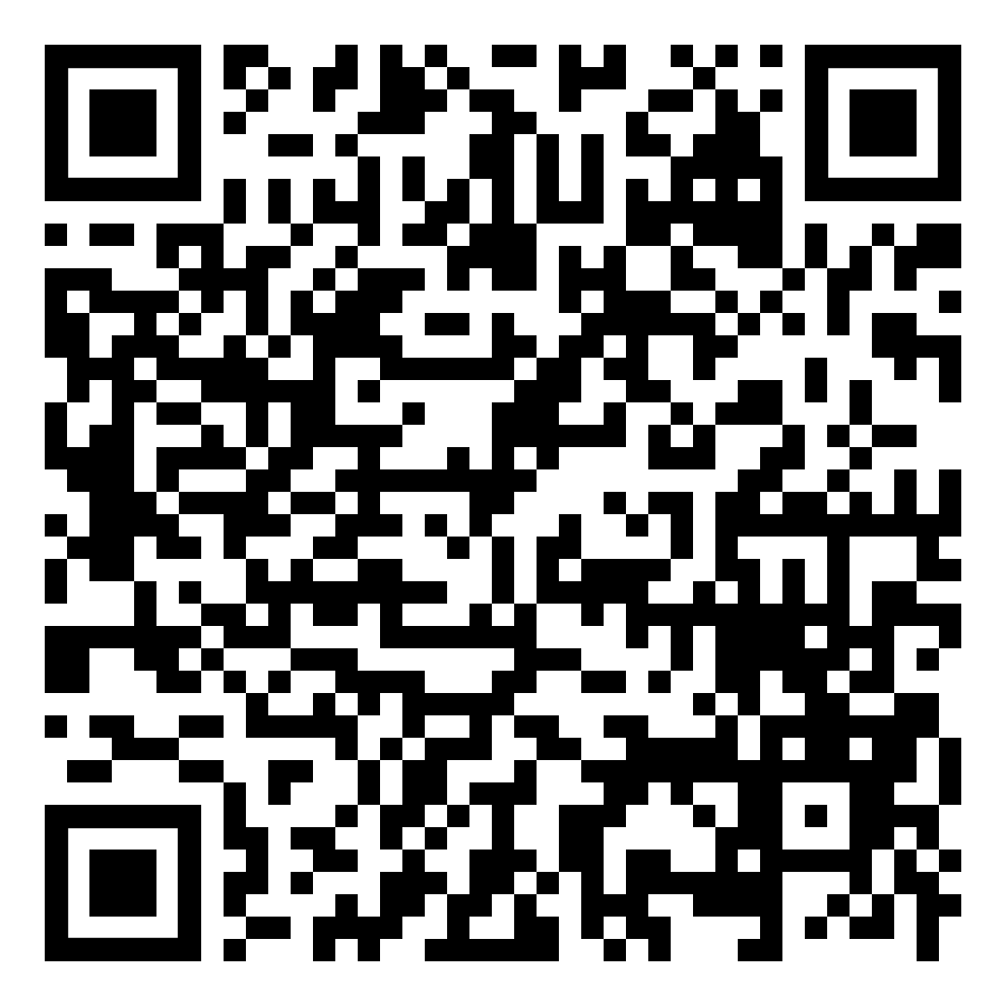
Species: chickadee photo

Slide 9
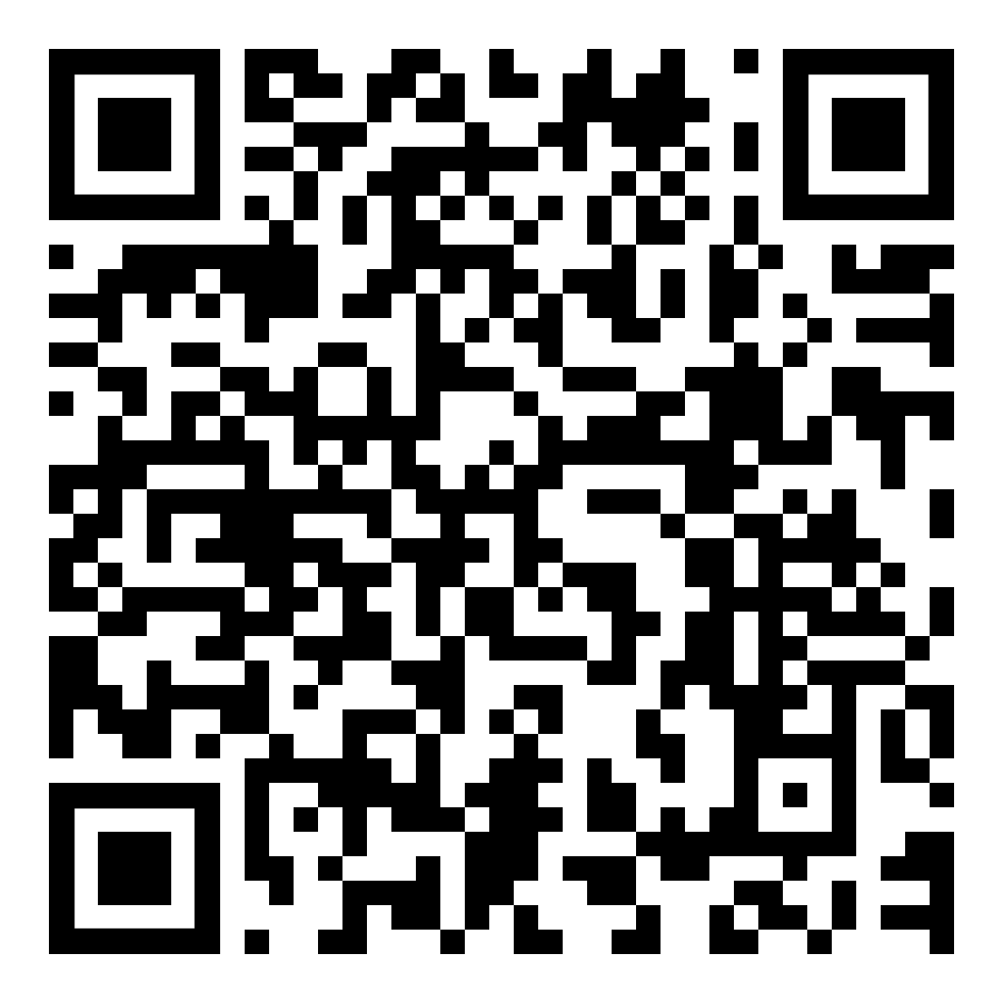
Species: 2 male mallard ducks

Slide 10
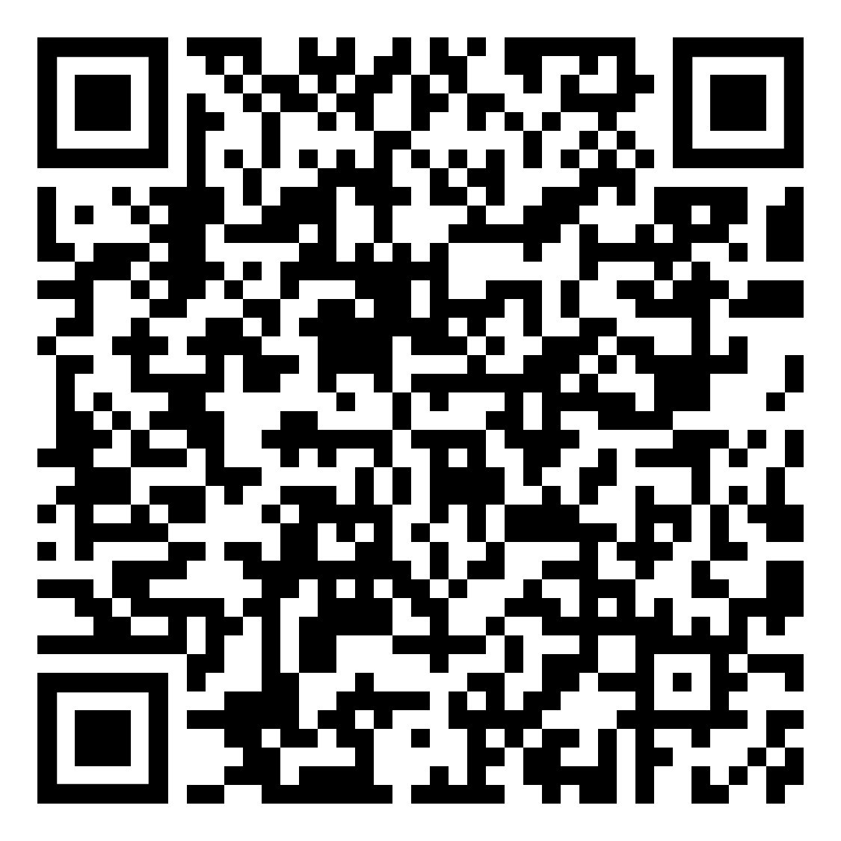
Species: American Robin

Slide 11
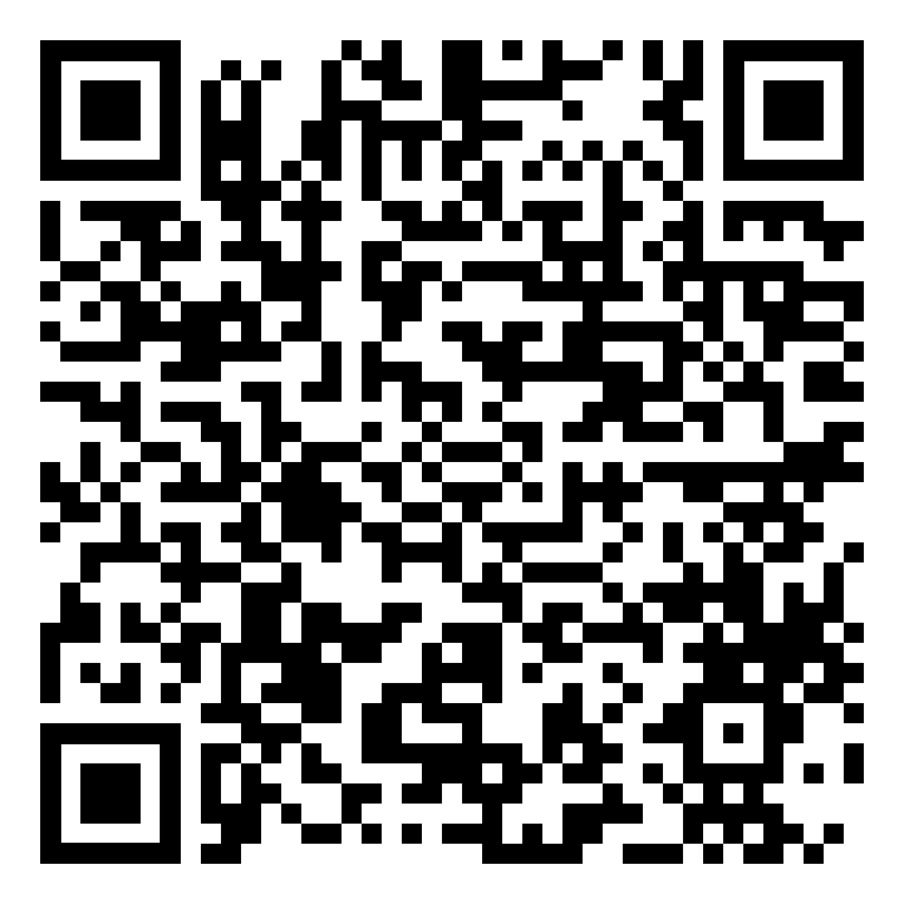
Species: prairie crocus pasqueflower

Slide 12
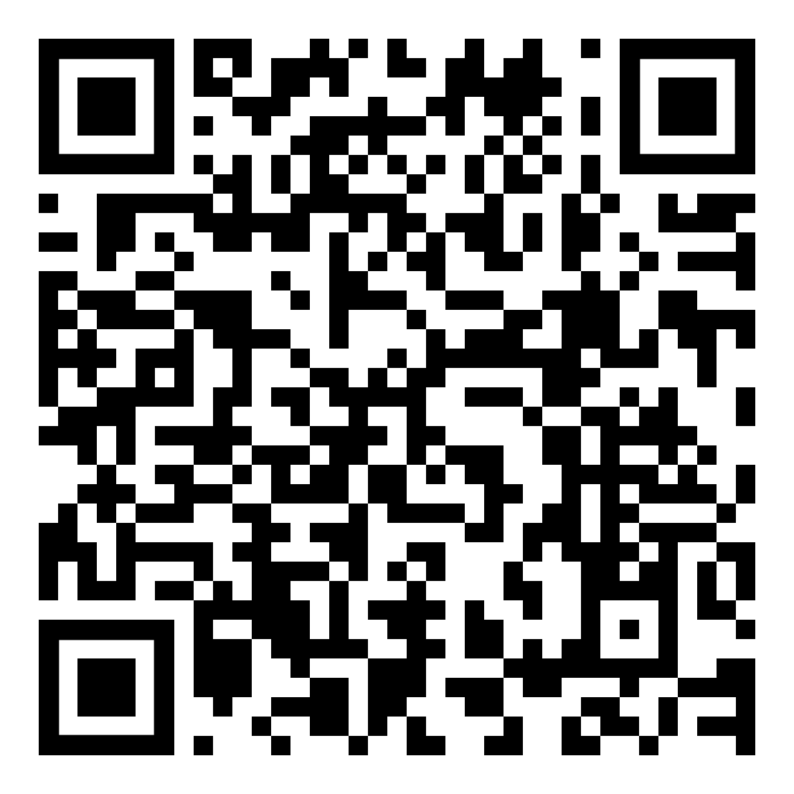
Species: caterpillar

Slide 13
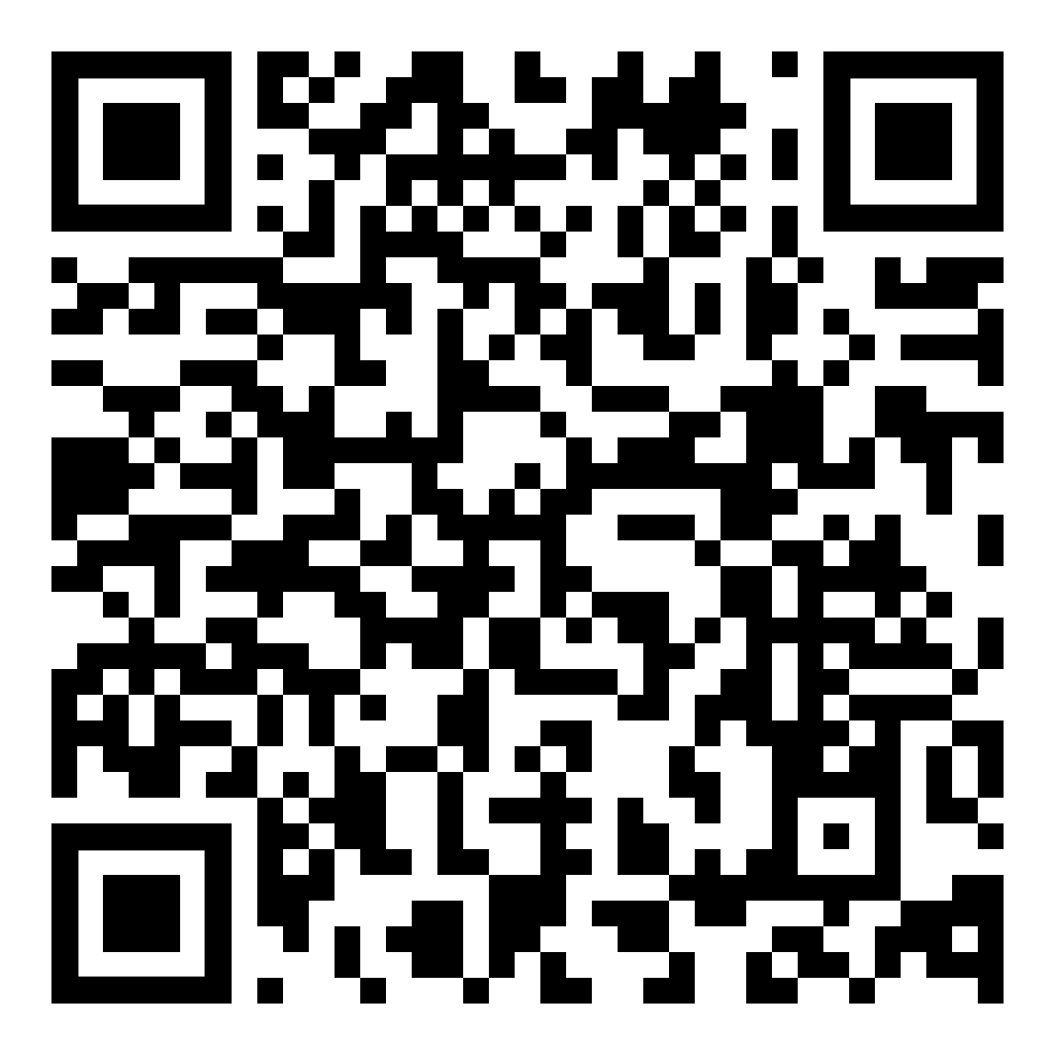
Species: coyote

Slide 14
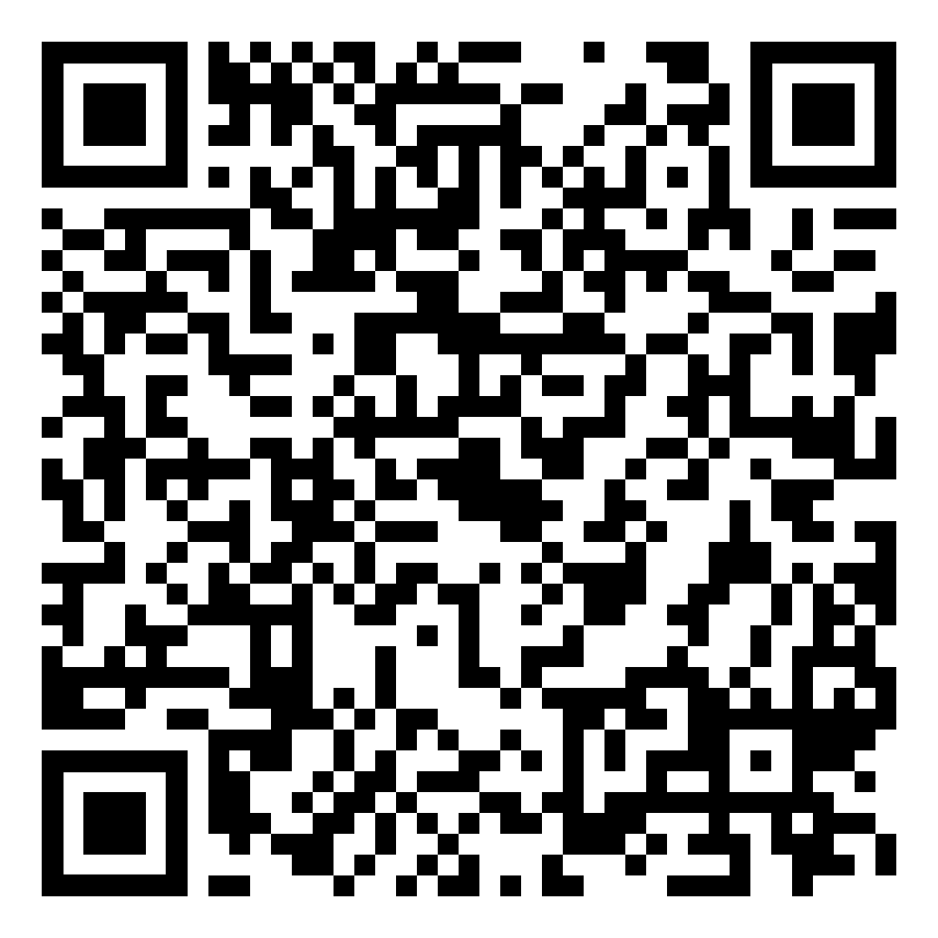
Species: bird egg

Slide 15
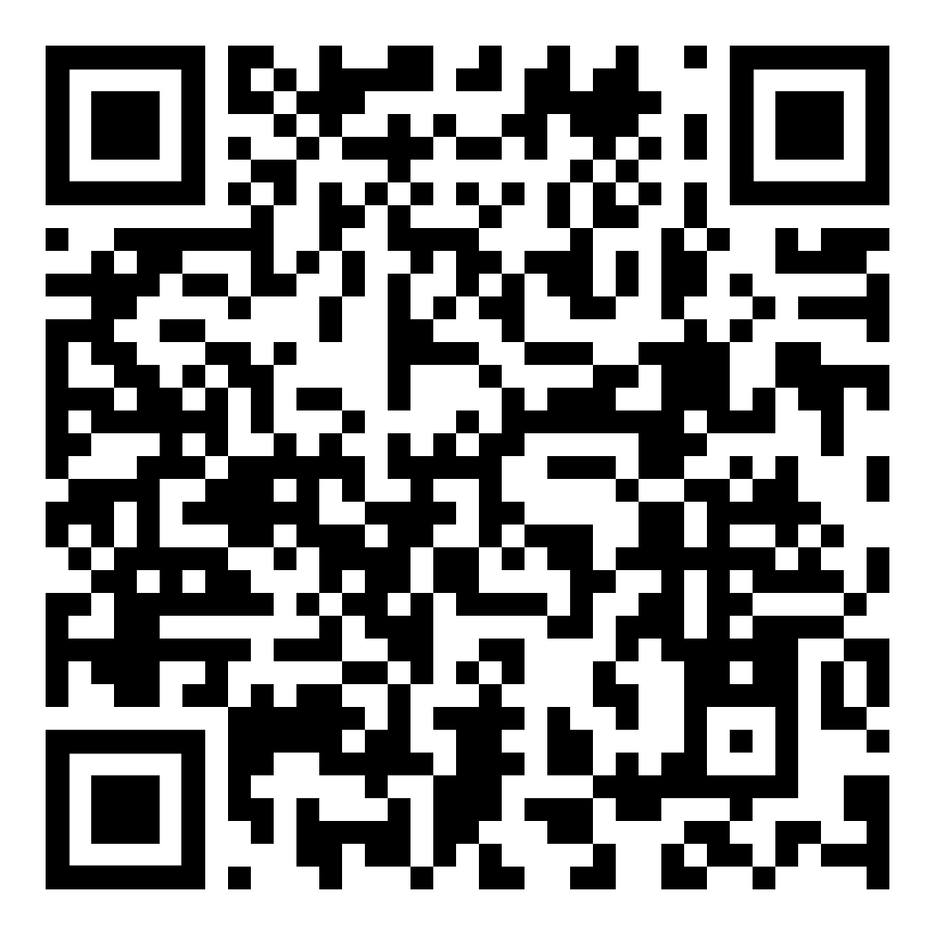
Species: Canada goose with chick

Slide 16
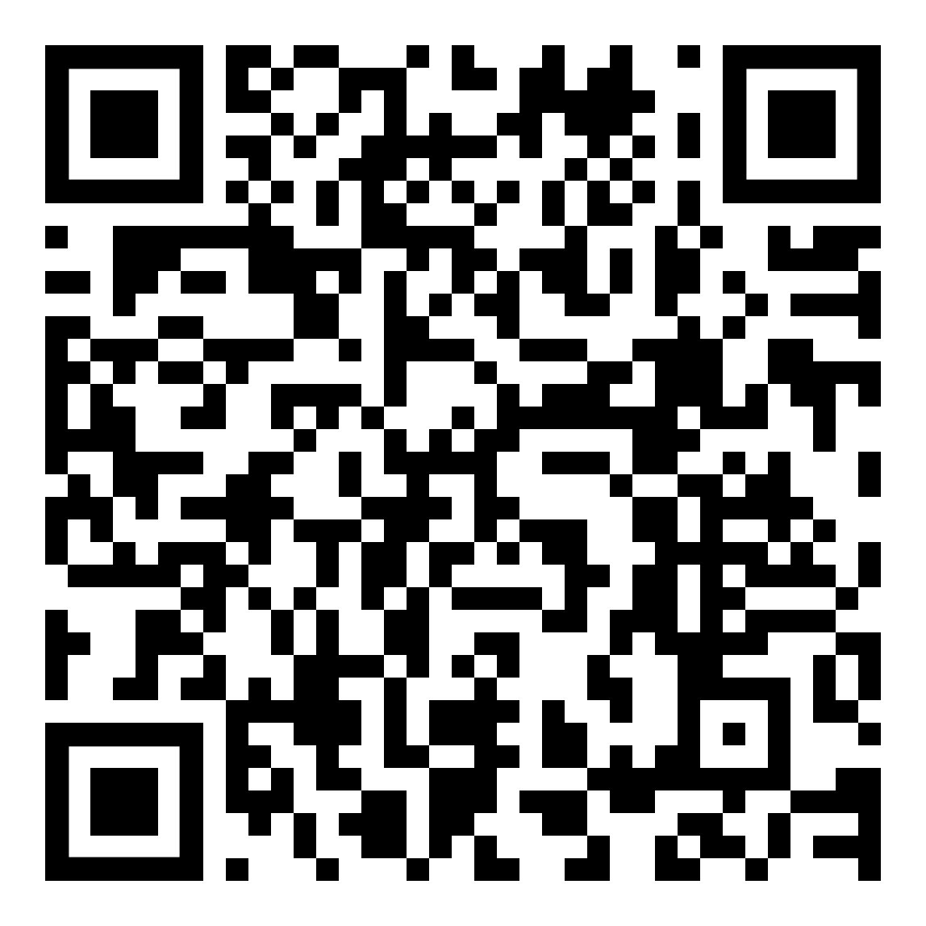
Species: squirrel

Slide 17
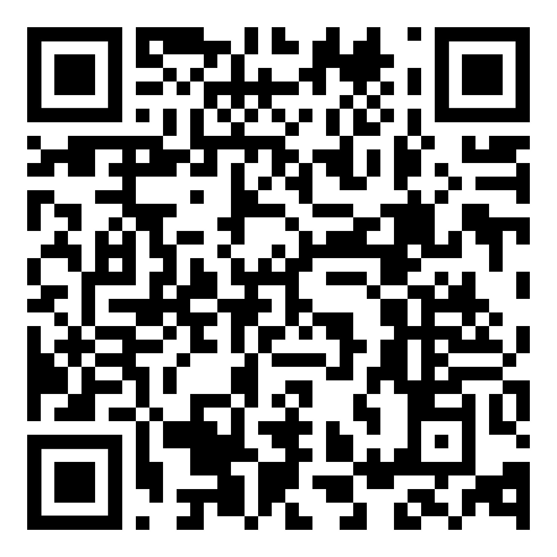
Species: white tail deer

Slide 18
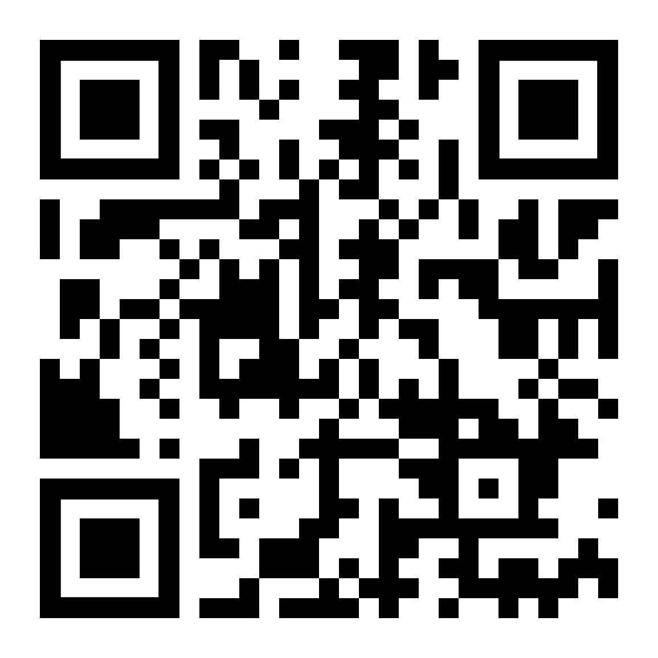
Species: tri coloured bumblebee

Slide 19
Grade 3 Pollinators

Slide 20
Grade 3 Pollinators
Lesson 4: how to take part in citizen science
QR code: 1

Slide 21
Grade 3 Pollinators
Lesson 4: how to take part in citizen science
QR code: 2

Slide 22
Grade 3 Pollinators
Lesson 4: how to take part in citizen science
QR code: 3

Slide 23
Grade 3 Pollinators
Lesson 4: how to take part in citizen science
QR code: 4

Slide 24
Grade 3 Pollinators
Lesson 4: how to take part in citizen science
QR code: 5

Slide 25
Grade 3 Pollinators
Lesson 4: how to take part in citizen science
QR code: 6

Slide 26
Grade 3 Pollinators
Lesson 4: how to take part in citizen science
QR code: 7

Slide 27
Grade 6 Pollinators

Slide 28
Grade 6 Pollinators
Lesson 4: how to take part in citizen science
QR code: 1

Slide 29
Grade 6 Pollinators
Lesson 4: how to take part in citizen science
QR code: 2

Slide 30
Grade 6 Pollinators
Lesson 4: how to take part in citizen science
QR code: 3

Slide 31
Grade 6 Pollinators
Lesson 4: how to take part in citizen science
QR code: 4

Slide 32
Grade 6 Pollinators
Lesson 4: how to take part in citizen science
QR code: 5

Slide 33
Grade 6 Pollinators
Lesson 4: how to take part in citizen science
QR code: 6

Slide 34
Grade 6 Pollinators
Lesson 4: how to take part in citizen science
QR code: 7

Slide 35
Grade 3 Birds

Slide 36
Grade 3 Birds
Lesson 4: how to take part in citizen science
QR code: 1

Slide 37
Grade 3 Birds
Lesson 4: how to take part in citizen science
QR code: 2

Slide 38
Grade 3 Birds
Lesson 4: how to take part in citizen science
QR code: 3

Slide 39
Grade 3 Birds
Lesson 4: how to take part in citizen science
QR code: 4

Slide 40
Grade 3 Birds
Lesson 4: how to take part in citizen science
QR code: 5

Slide 41
Grade 3 Birds
Lesson 4: how to take part in citizen science
QR code: 6

Slide 42
Grade 3 Birds
Lesson 4: how to take part in citizen science
QR code: 7

Slide 43
Grade 6 Birds

Slide 44
Grade 6 Birds
Lesson 4: how to take part in citizen science
QR code: 1

Slide 45
Grade 6 Birds
Lesson 4: how to take part in citizen science
QR code: 2

Slide 46
Grade 6 Birds
Lesson 4: how to take part in citizen science
QR code: 3

Slide 47
Grade 6 Birds
Lesson 4: how to take part in citizen science
QR code: 4

Slide 48
Grade 6 Birds
Lesson 4: how to take part in citizen science
QR code: 5

Slide 49
Grade 6 Birds
Lesson 4: how to take part in citizen science
QR code: 6

Slide 50
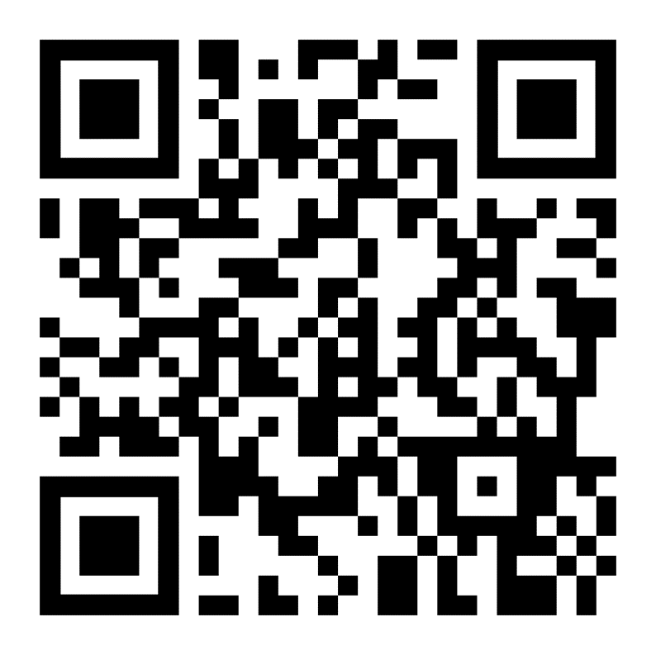
Grade 6 Birds
Lesson 4: how to take part in citizen science
QR code: 7

Slide 51
Grade 7 and 9 Urban Wildlife

Slide 52
Urban Wildlife
QR CODE | Grade 7 | Grade 9
1 | Mallard ducks | Mallard ducks
2 | Red winged blackbird | Red winged black bird
3 | Coyote | Coyote
4 | White tailed Deer | White tailed Deer
5 | Squirrel | Squirrel
6 | Prairie crocus | Prairie crocus
7 | Tri-coloured bumble bee | Tri-coloured bumble bee

Slide 53
Urban Wildlife
Lesson 4: how to take part in citizen science
QR code: 1

Slide 54
Urban Wildlife
Lesson 4: how to take part in citizen science
QR code: 2

Slide 55
Urban Wildlife
Lesson 4: how to take part in citizen science
QR code: 3

Slide 56
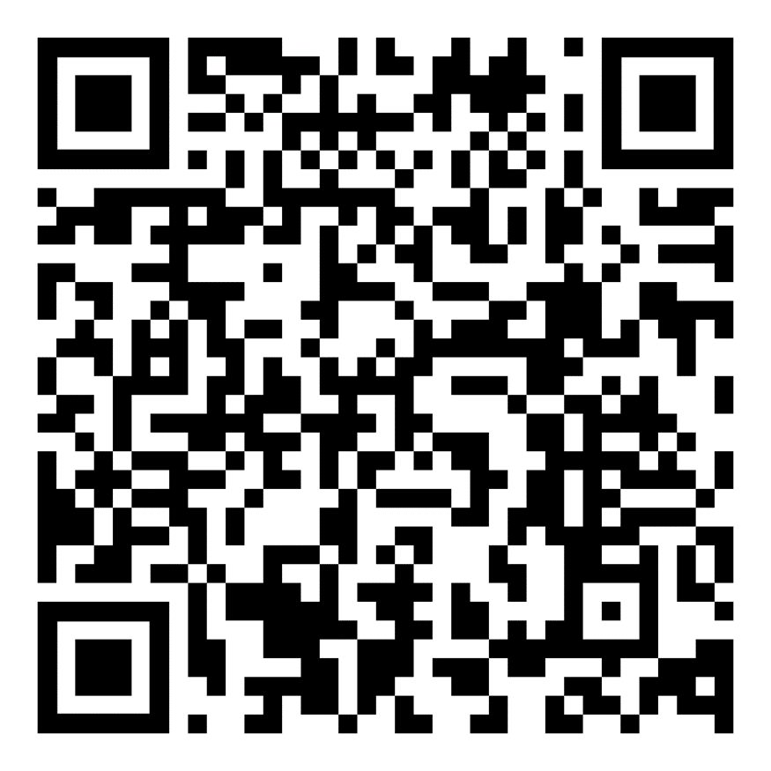
Urban Wildlife
Lesson 4: how to take part in citizen science
QR code: 4

Slide 57
Urban Wildlife
Lesson 4: how to take part in citizen science
QR code: 5

Slide 58
Urban Wildlife
Lesson 4: how to take part in citizen science
QR code: 6

Slide 59
Urban Wildlife
Lesson 4: how to take part in citizen science
QR code: 7

